Slide 1
Community Engagement & Mapping

Slide 2
Check-in & Icebreaker
You need a village, if only for the sake of leaving it behind.
Having a village means you are never alone,
knowing that there is something of you in the people, the trees, and the soil, which stays there waiting for you, even when you’re away.
Cesare Pavese

Slide 3
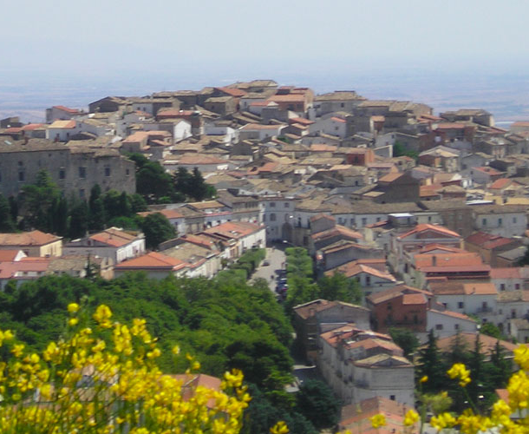
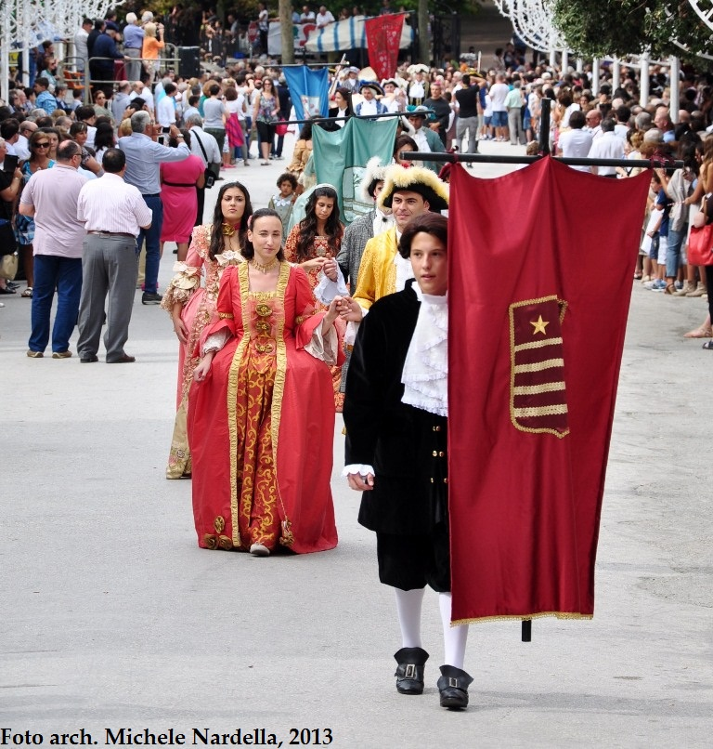
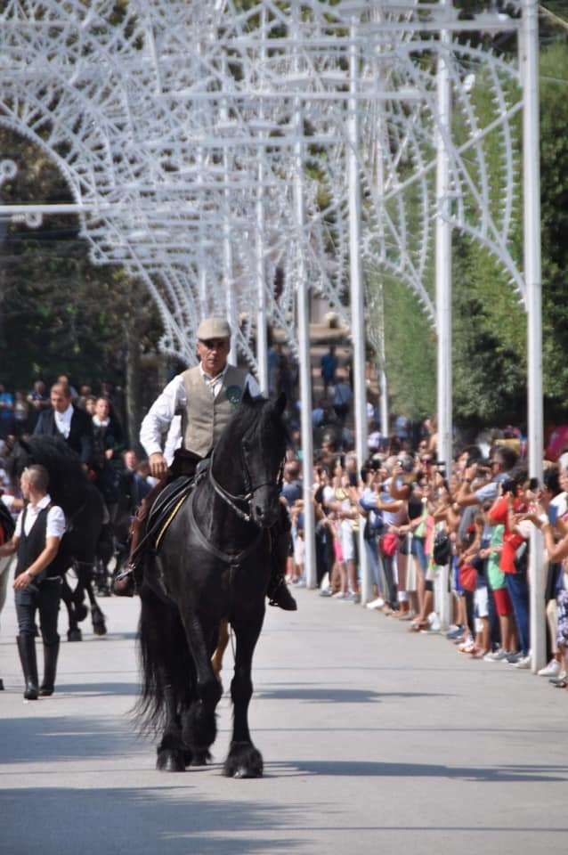
Check-in & Icebreaker

Slide 4
Check-in & Icebreaker
10’
How does your local community currently view its own heritage?
Does the community there feel proud of their ICH, or is it overlooked?

Slide 5
Learning Outcomes
Community Engagement/Community mapping –
How can we make people engage with the place and discover all wonderful things about it and its ICH?
We will explore how to engage local residents to ensure their unique intangible heritage—their stories, skills, and traditions—don't disappear, but instead become the heart of sustainable development.

Slide 6
Learning Outcomes
By the end of this session, you will:
Analyze the strategic importance of community engagement for sustainable tourism
Master the "Ladder of Participation" to move from informing to co-creation
Apply the Asset-Based Community Development (ABCD) method to your Training Case

Slide 7
What is a Community?
1. Place and territorial identity
Symbolic places: locations that hold collective meaning (a specific square, a sacred tree, or a historical ruin).
Boundaries: not just legal borders, but the mental map of where "home" ends and the "outside world" begins.
2. Social interactions and bonds
Formal networks: local associations, cooperatives, or parish councils.
3. Shared heritage (ICH)
Traditions and rituals: festivals like the Festa dei ceri, religious processions, or seasonal harvests.
Language and stories: local dialects, myths, and oral histories that explain "who we are.“
Skills and craftsmanship: unique ways of building, cooking, or creating that are specific to that remote location.
4. Common interest and belonging
The diaspora: people who have left but still identify with the village’s success and traditions.
Psychological sense of community: the feeling of "membership" and the belief that members matter to one another.
Shared vision: a common goal, such as wanting to save a local school or develop sustainable tourism.
Informal networks: family ties, friendships, and the "bar talk" where information is exchanged.
Intergenerational links: the connection between the elderly and the youth.
The landscape: how the physical environment shapes daily life.
Notes:
A group of people living in the same area isn’t necessarily a community

Slide 8
What is Engagement?
Engagement is not generally driven by a 'model' so much as by a framework of guiding principles, strategies, and approaches.
This framework is based on principles that respect the right of all community members to be informed, consulted, involved, and empowered.
Community engagement employs a range of tools and strategies to ensure success.

Slide 9
What is Community Engagement?
Community engagement is a blend of science and art.
The science comes from sociology, public policy, political science, cultural anthropology, organizational development, psychology, social psychology, and other disciplines. It also comes from organizing concepts drawn from the literature on community participation, community development, constituency building, and community psychology.
The art comes from the understanding, skill, and sensitivity used to apply and adapt the science in ways that fit the community and the purposes of specific engagement efforts.

Slide 10
Why do we need Community Engagement?
Tourism, especially rural tourism, has the potential to harm the environment and to have adverse impacts on the local communities unless carefully planned and managed.
Appropriate strategies would ensure the realization of the benefits associated with tourism while limiting its adverse impacts, especially on the natural environment and the local culture.
The nature and complexity of rural tourism necessitate the adoption of a holistic approach that takes into account the diversity of the resources utilized and the stakeholders involved.

Slide 11
Why do we need Community Engagement?
Counteracting processes of homogenization, often described as “Disneyfication”, is essential for maintaining the integrity of tourism destinations.
Active community engagement plays a key role in preserving local distinctiveness—the unique “fingerprint” that defines a place. By involving residents and local actors, it becomes possible to resist standardization and to foreground what is authentic, lived, and embedded in everyday practices.
In this way, tourism can shift from a model based on extraction and simplification toward one that supports the conservation and continuity of local identity and heritage.

Slide 12
Why do we need Community Engagement?
Positioning heritage as a tool for social cohesion is central to more inclusive tourism development.
Active engagement in heritage-related initiatives can strengthen both bonding and bridging ties, fostering connections across generations and diverse social groups. Through participation, residents may develop greater confidence, skills, and a sense of agency, which can support processes of social inclusion and, in some cases, facilitate pathways toward employment.
By prioritizing community wellbeing alongside visitor experience, heritage-based approaches can also contribute to enhancing the overall liveability of a place, reinforcing its social fabric as well as its cultural vitality.

Slide 13
community-based approach in rural tourism development
Active involvement and participation of residents in the tourism development process seem to be prerequisites for achieving the goal of sustainability and thereby improving the overall welfare in the community.
Rural tourism development should be community based and involve a multidimensional sustainability strategy.

Slide 14
community-based approach in rural tourism development
By operating through local community leaders and trusted structures, you can help create conditions for cooperation and collective stewardship, which are essential for sustaining intangible cultural heritage over time.
At the same time, their mediating role can support a more balanced integration of heritage into tourism, potentially reducing risks of misrepresentation or over-commercialization.
Identifying effective stakeholders and understanding their shared characteristics may therefore provide valuable insights for designing tourism initiatives that contribute to the safeguarding, rather than the erosion, of intangible cultural heritage.

Slide 15
Activity 30’
What could be the risks related to the preservation and/or creation of a touristic product based on ICH?
How could community engagement counterbalance them?
Notes:
10.10

Slide 16
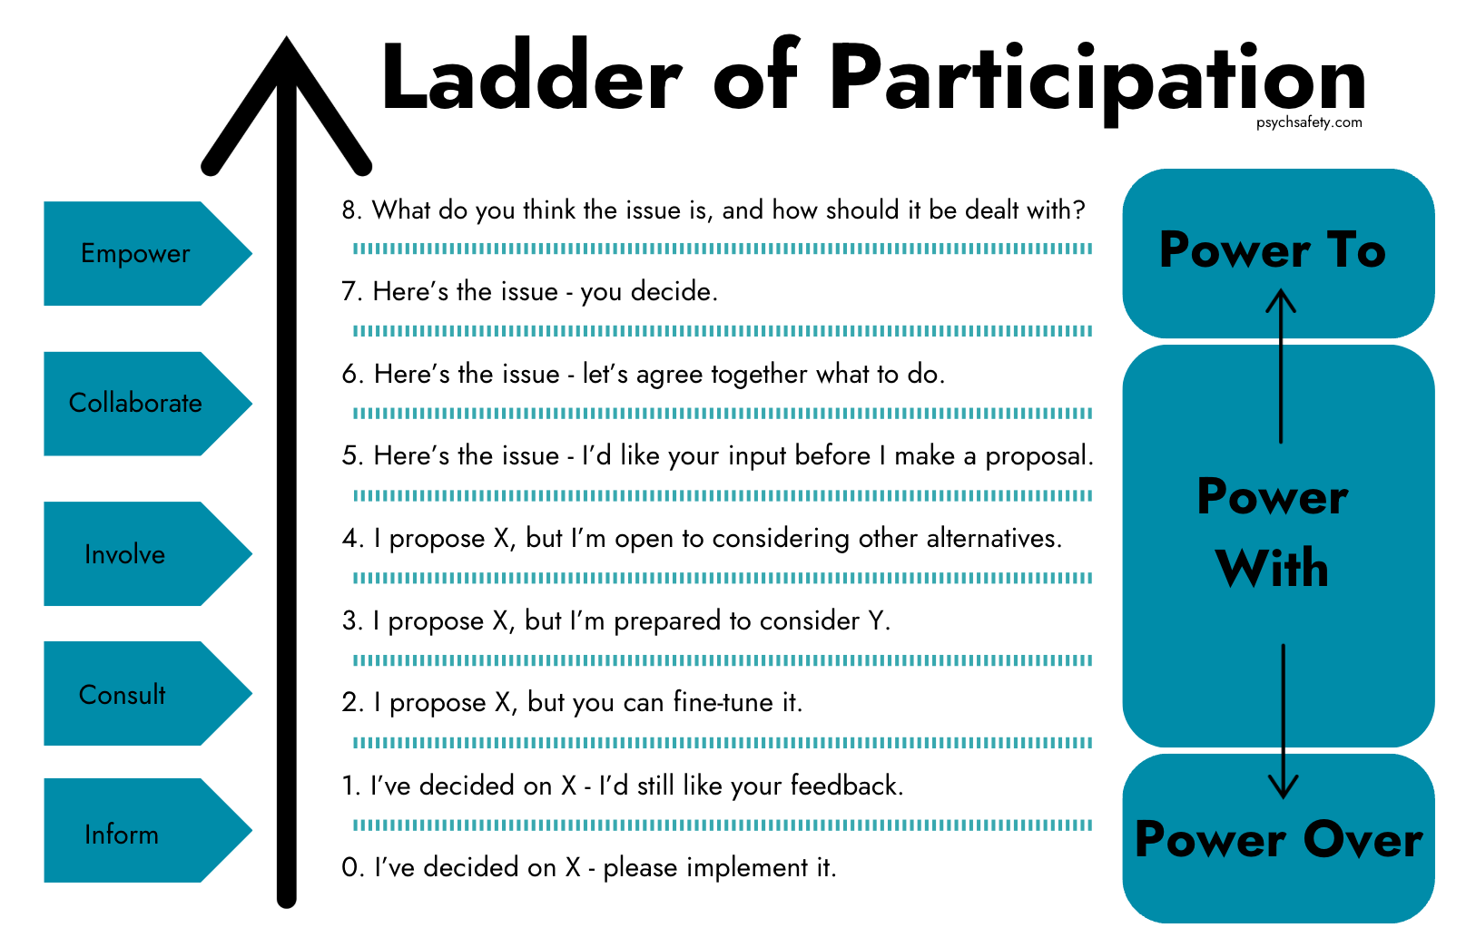
How to engage?
Notes:
11.00

Slide 17
How to effectively engage a community?
Trust
Transparency
Inclusion

Slide 18
How to effectively engage a community?
Go to them: don’t expect the community to come to a formal meeting; meet them where they already gather (the local cafe, the church square, the harvest).
Listen first: engagement starts with listening to their stories before proposing anything.
Reciprocity: what does the community get back? (e.g., a digital archive of their family photos, a sense of pride, or new skills)

Slide 19
How to effectively engage a community?
Participation in heritage and tourism initiatives is often uneven, with certain groups—such as youth, migrants, or economically vulnerable residents—facing structural barriers to access and representation. Without deliberate efforts, these dynamics risk reinforcing existing inequalities and privileging selective interpretations of heritage.
Adopting more inclusive approaches—such as co-design processes, targeted outreach, and capacity-building—can help broaden participation, recognize a wider diversity of cultural expressions, and support a more equitable distribution of the social and economic benefits associated with tourism.

Slide 20
Activity 30’
Select a remote area from your training case.
Identify 3 hidden assets (a story, a skill, a ritual).
Define one method to involve the local community (or diaspora) in sharing these.
Notes:
11.20

Slide 21
Community Mapping
Community mapping is a participatory process where the people living in a specific area work together to create a visual representation of their local world.
Notes:
12.10

Slide 22
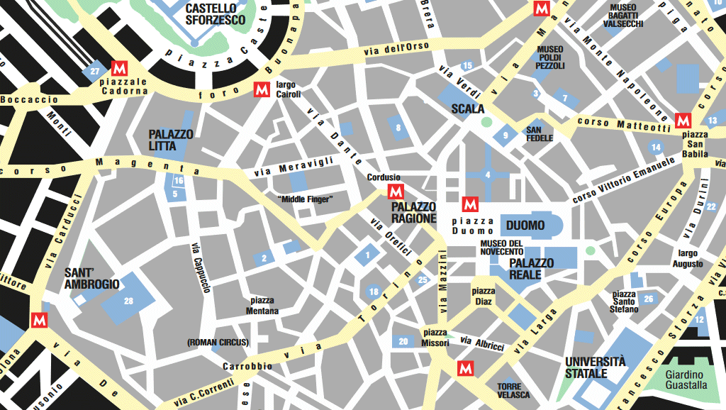
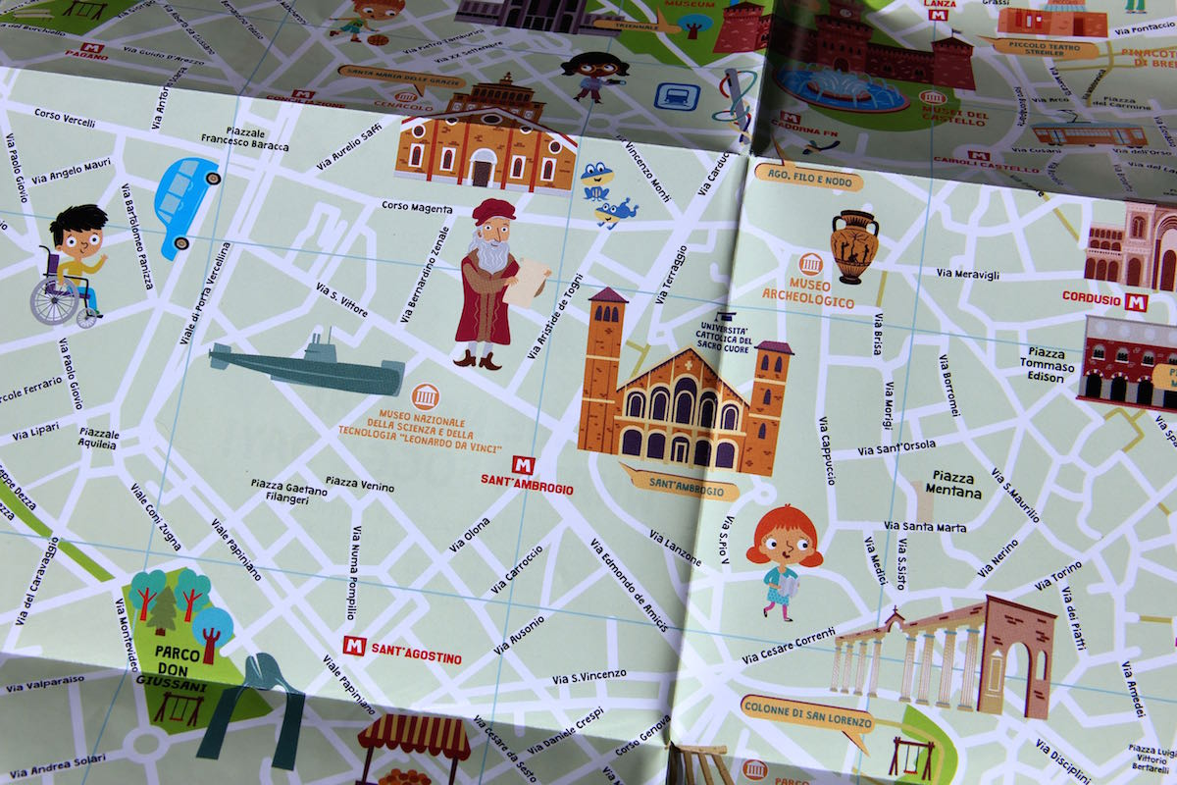
Community Mapping
Standard Mapping: Focuses on accuracy, topography, and navigation.
Traditional maps are usually made by professionals (cartographers) using satellite data.
Community Mapping: Focuses on stories, resources, social connections, and local priorities.
Community mapping is made by residents using local knowledge.

Slide 23
Community Mapping
Community mapping is one of the most powerful tools available for promoting Intangible Cultural Heritage (ICH) because it solves the biggest problem ICH faces: invisibility.

Slide 24
Activity 30’
Notes:
12.20

Slide 25

Are we a community?
1. Place and territorial identity
2. Social interactions and bonds
3. Shared heritage (ICH)
4. Common interest and belonging
Notes:
A group of people living in the same area isn’t necessarily a community

Slide 26
Community Mapping
Take your group map and draw the city you’ve discovered over the last days. Don’t just mark the famous buildings—draw the life you’ve seen in the streets: the specific corners where you heard local music, the squares where you watched people gather, and the sensory spots (like the smell of woodsmoke or the echo of the alleys) that surprised you.
Mark the places where you felt a connection to a tradition from your own home country or where you noticed a unique "unwritten rule" of the city.
Use colors and symbols to turn this paper map into a personal record of your shared international experience here.

Slide 27
Debriefing & Reflection
How does mapping improve your tourism product?
Take your identified assets and think: how does involving the community make your final product more authentic?

