Slide 1

#ASenseofEU - Training Mobility in Italy
Co-funded by the European Union.
Grant Agreement No. 2024-1-IS01-KA220-ADU-000251000
The European Commission support for the production of this publication does not constitute an endorsement of the contents which reflects the views only of the authors, and the Commission cannot be held responsible for any use which may be made of the information contained therein.
Intangible Cultural Heritage-based tourism in remote and rural areas
Gubbio (Umbria - iTALY) | 23–27 March 2026

Slide 2

Structure of the session
In this session, we will explore:
Rural tourism and cultural tourism
Intangible Cultural Heritage as a tourism resource
What is a tourism product and its key components
The concept of tourism experience and its characteristics
How to design and produce meaningful tourism experiences

Slide 3
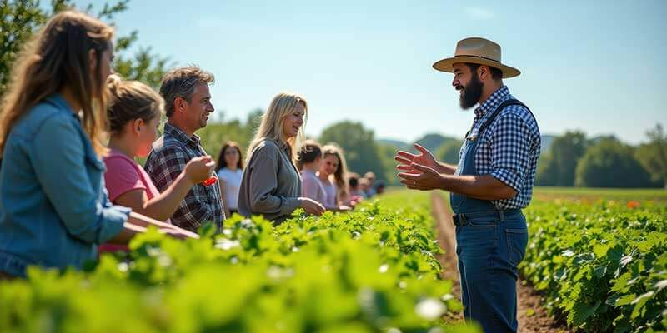
RURAL ToURISM definition
A type of tourism activity in which the visitor's experience is related to a wide range of products generally linked to nature-based activities, agriculture, rural lifestyle / culture, angling and sightseeing.
Rural tourism activities take place in non-urban (rural) areas with the following characteristics: i) low population density, ii) landscape and land use dominated by agriculture and forestry, and iii) traditional social structure and lifestyle. (UNWTO)
According to Eurostat, a large share of tourism in the EU takes place in rural areas (33,6% in 2022)
Notes:
UNWTO agency of the United Nations responsible for tourism at global level

Slide 4

RURAL ToURISM & intangible cultural Heritage (ICH) tourism
Rural tourism and tourism based on Intangible Cultural Heritage are closely interconnected
Rural tourism is largely rooted in traditions, local knowledge, and cultural practices. Many experiences offered in rural areas - such as gastronomy, traditional crafts, and rituals - are expressions of Intangible Cultural Heritage.
Consequently, a significant share of tourism taking place in rural areas can be understood as cultural tourism.
We therefore introduce cultural tourism and its main characteristics.
Notes:
Rural areas are often the custodians of traditions and local cultures, which forms what we call Intangible Cultural Heritage. They are also places where Sense of Place is more preserved
Intangible cultural heritage are traditions, practices, or living expressions of a group or community. This can include oral traditions, performing arts, social practices, rituals, festive events, and traditional crafts.

Slide 5
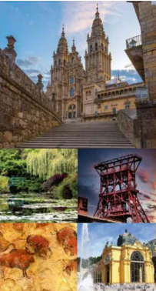
Cultural tourism
A type of tourism activity in which the visitor’s essential motivation is to learn, discover, experience and consume the tangible and intangible cultural attractions/products in a tourism destination.
These attractions/products relate to a set of distinctive material, intellectual, spiritual and emotional features of a society that encompasses arts and architecture, historical and cultural heritage, culinary heritage, literature, music, creative industries and the living cultures with their lifestyles, value systems, beliefs and traditions (UNWTO)
Image from: Cultural Routes of the Council of Europe
Notes:
Cultural tourism refers to a type of tourism in which the visitor’s main motivation is to learn, discover, experience, and consume cultural resources.
These resources include both tangible and intangible elements.
Tangible elements include monuments, architecture, and physical heritage.
Intangible elements include traditions, gastronomy, knowledge, rituals, and ways of life.
This definition highlights that tourism is not only about seeing places, but also about understanding cultures and connecting with local identity.

Slide 6
Cultural tourism: evolution
From tourism based on tangible cultural heritage to tourism based on intangible cultural heritage: focus on the intangible dimension of the cultural heritage of a territory and the community that inhabits it (knowledge, techniques, arts, traditions, rituals and re-enactments, etc.)
Demands for complex, non-standardized products based on experiences and emotions (participation in religious rituals and historical reenactments, sampling local cuisine, observing traditional craft techniques, etc.)
Notes:
Over time, cultural tourism has evolved significantly.
In the past, cultural tourism was mainly focused on tangible heritage, such as monuments, museums, and historical buildings.
Today, the focus has shifted toward intangible cultural heritage.
Tourists are increasingly interested in experiences that involve traditions, local knowledge, gastronomy, craftsmanship, and daily life.
This reflects a broader transformation in tourism demand, where visitors are looking for emotional, meaningful, and participatory experiences.
Examples:
Instead of only visiting a museum about ceramics, tourists participate in a pottery workshop with a local artisan.
Visitors don’t just go to a restaurant to enjoy a traditional local dish; they first take part in a cooking class to learn how to make

Slide 7

What do tourists buy?
What is a tourism product?
What components does it consist of?
Notes:
Before we go further, I would like to ask you a simple question:
What do tourists actually buy?
Take a moment to think about your own travel experience.
What do you usually pay for when you travel?
Looking at your answers, we can see that tourists do not simply buy a hotel room or a meal.
They buy a set of elements that together create an experience.
So the next question is: what exactly is a tourism product? What elements does it include?

Slide 8

TOURISM PRODUCT
Tourism Product: Definition
The set of tangible and intangible attractions that motivate travel to a destination, together with the services that make their consumption possible.
Notes:
Example of Gubbio:
Tangible attractions: medieval architecture, monuments (Palazzo dei Consoli), historic streets
Intangible attractions: local traditions (e.g. Festa dei Ceri), history, cultural identity
Services: accommodation (hotels, B&Bs), restaurants, transport to reach the destination, local mobility, visitor information, guided tours

Slide 9
Tourism product: components
Attractors
Respond to motivation/s
Infrastructure
Context for service provision and use of attractions
IMAGE
Services
Allow access to and enjoyment of attractions (tourism services, transport services, etc.)
ATTRACTORS
SERVICES
Image
Set of opinions,impression, and feelings that people have about the destination
INFRASTRUCTURE
Notes:
Attractors: they represent the basic components of the offer that motivate tourists to travel, such as natural resources, artistic and cultural heritage, gastronomy, cultural, sports, and religious events, as well as activities to be experienced.
Services: accommodation and catering services: hotels, restaurants, bars, transport services: transport companies / carriers, tour operators, travel agencies
Infrastructure and image belong to the broader destination context.
They create the environment in which the core components of the tourism product are embedded.
Infrastructure: Transport: roads, airports, railways, ports: Commercial services: banks, shops, shopping centres; Healthcare & utilities: hospitals, pharmacies, water and energy services; Public & safety services: municipal police, fire services, civil protection;
Image is important because it strongly influences the tourist’s decision-making process, strongly influences tourists when deciding whether to visit.

Slide 10
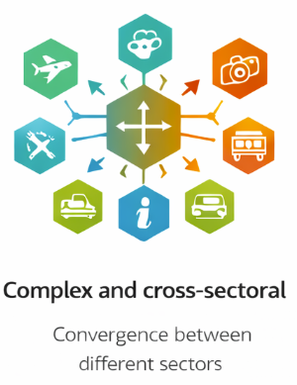
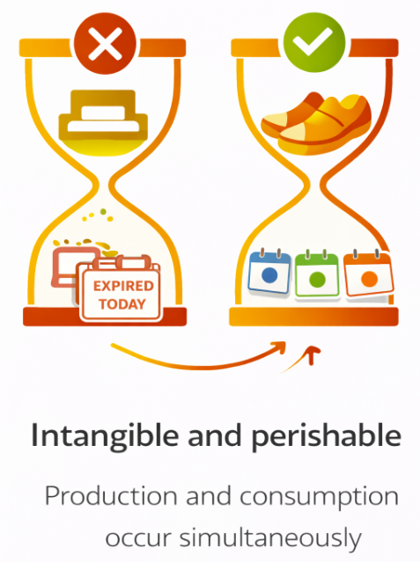
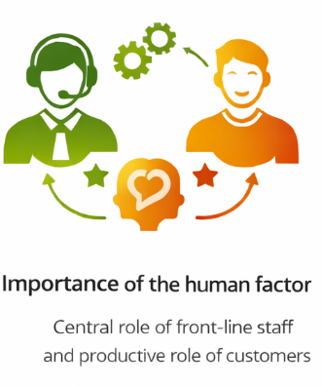
Tourism product
Characteristics
Notes:
Tourism is complex because it involves many different sectors, such as attractions, transport, hotels, restaurants, and other services. All these elements work together to create the tourism experience.
Tourism is also intangible and perishable. It is intangible because it cannot be physically touched, as it mainly consists of experiences. It is perishable because it cannot be stored; for example, a hotel room that is not sold today is lost forever. Revenue lost today is lost forever. In addition, production and consumption happen at the same time, because tourists experience the service while it is being delivered.
Tourism is not a physical product. Visitors cannot see or try the experience before buying it, so communication is essential to help them imagine what they will live.
Tourism services cannot be stored. If an experience is not booked, the opportunity is lost. For this reason, it is important to make the product easy to find and easy to book.
This is especially important in rural and marginal areas, where destinations are less known and visitor flows are less predictable. Clear communication, storytelling and accessible sales channels help reduce uncertainty and attract visitors.
Finally, the human factor plays a very important role. Staff members influence the quality of the experience through their professionalism and interaction with customers. At the same time, the customer actively participates in the service and is not just a passive consumer. For this reason, the tourism experience strongly depends on human interactions.

Slide 11
How to design a product?
Where to start when designing a tourism product?

Slide 12
Tourism product design
Tourists are not all the same
Divide tourists into different groups (segmentation)
Choose the group to address
Describe in detail this group (profiling)
Understand the needs (requirements) of this group
Design the tourism product based on these needs
Notes:
Tourists are not all the same. It is impossible for a tourism product to satisfy everyone
They have different motivations, interests, expectations, and travel styles.
Some look for relax, others for adventure, others for cultural learning or authentic local experiences.
For this reason, tourism products need to be designed for specific groups of visitors.
This process is called market segmentation.

Slide 13

Tourism product design
The segmentation process
Divide the market into groups of customers that are homogeneous and clearly differentiated from other groups
Choose who to serve (one or more target markets) and who not to serve
Specialise in serving target markets and any contiguous segments
Notes:
Tourists have different needs, expectations, and personal characteristics. It is impossible for a tourist product to satisfy everyone
A family with children needs short visits, safe areas, and activities that are easy and interesting for kids
An older visitor needs easy access, places to rest, and a slower pace.
Some visitors expect a structured guided tour
Others expect to explore freely and at their own pace
Some visitors prefer luxury hotels and organised services
Others prefer low-cost options and simple accommodation
Divide customers into groups of people who are similar to each other and different from other groups.

Slide 14
Tourism product design
Segmentation criteria: variables that allow you to divide your market into meaningful customer groups
Geographical (city/region/state of origin, population density, climate, etc.)
Demographic (age, gender, family unit and its life cycle, family status, educational qualifications, occupation, income, religion)
Behavioural (motivations, booking behaviours, frequency of travel, sensitivity to price or risk, etc.)
Psychographic (lifestyle, values, interests, personality, favorite activities, opinions, etc.)
Notes:
Geographical: Domestic tourists vs International tourists
Demographic: Families with children vs Young adults travelling alone or with friends
Behavioural: Tourists who book well in advance vs Tourists who book at the last minute
Psychographic: People with an active lifestyle vs People with a relaxed lifestyle

Slide 15

Tourism product Design
Choosing demand targets
Segmentation helps identify different types of tourists and understand which groups are most suitable for the tourism product.
One or more target groups can be selected.
If more than one group is selected, the groups should have similar needs and expectations.
These target groups are then described in more detail (profiling).
Notes:
After segmentation, we choose which group of tourists we want to focus on.
Examples:
A: We choose young adults travelling with friends
B: We choose families with children
We cannot serve everyone, so we choose our target.

Slide 16

Tourism product Design
Profiling demand
Customer profile: a set of objective characteristics that allow one customer to be distinguished from another and grouped into homogeneous groups on which to build targeted offers (product design)
It is based on the acquisition and analysis of data on tourist consumption behavior (how they choose, buy, arrive, stay, etc.)
It should be done from the customer's point of view
Notes:
Now we describe our target in detail.
Examples:
Example A – Young adults
Young adults (25–35), international travellers, who travel frequently.
They have an active lifestyle and enjoy discovering new places.
They are interested in authentic experiences, local culture and meeting local people.
Example B – Families with children
Families with children (30–45), mainly domestic travellers, who travel occasionally.
They have a relaxed lifestyle and look for safe and enjoyable activities for both adults and children.
They are interested in nature, local traditions and educational experiences.
Now we clearly understand who our visitors are and what they are looking for.

Slide 17

Tourism product Design
Profiling demand
The output is a list of requirements hierarchically classified according to their relevance to the target audience: advantages that the customer expects or dreams of obtaining and disadvantages feared before, during, and after consumption
The customer profile is the basis for the design of tourism products
Notes:
We identify what this target needs and expectations.
Examples:
Young adults: Need flexibility, clear information, easy booking, active participation, contact with local people
Family: Need safe activities, suitable for adults and children, simple organisation, educational and enjoyable experiences
Now we understand what they need.

Slide 18

Tourism product Design
The design process
The design process takes into account the tourists’ profile, based on their needs (requirements), in order to identify product specifications that meet those needs.
Tourism product design process
CUSTOMER PROFILE
-
Requirements
PRODUCT DESIGN
-
Specifications
Notes:
We transform needs into concrete elements of the product.
Examples:
Adults travelling with friends: Provide flexible booking and clear communication
families with children: Provide structured organisation and clear schedules
Now we start building the product.

Slide 19

Tourism product Design
The design process
Each requirement must be translated into a design specification
A requirement that does not correspond to a specification is an unmet requirement and may lead to tourist dissatisfaction
A specification that does not correspond to any requirement increases costs and may lead to a negative customer evaluation
Notes:
Example:
If visitors expect guided interpretation of traditions, a trained local guide should be part of the experience.
Every need must be translated into something real in the product.
Examples:
A: If tourists need flexibility but booking is rigid → bad experience
B: If families need clarity but information is unclear → confusion
If a need is not satisfied, the experience will not work.

Slide 20
How to design a Tourist experience?
What is an experience in today's tourism industry?
What makes a tourism experience memorable?
What would you consider when designing a tourism experience?
Notes:
Before we try to define what a tourism experience is, I would like you to think about your own travel experience.
Think of a trip that you remember particularly well.
What made that experience memorable?
How do we create a tourism experience? How can we transform a tourism product into an experience?

Slide 21
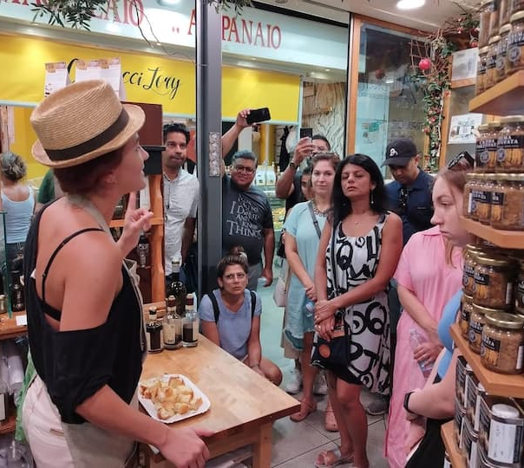
The tourism experience: definition
A tourism experience is the subjective, emotional and memorable outcome of a visitor’s interaction with a destination.
It engages the senses and emotions, creates authentic relationships with the host community, and generates a sense of immersion in a place or activity that transforms simple visits into meaningful and lasting memories.
Notes:
The experience is personal, involves the senses, creates connections on an emotional, physical, intellectual or social level with the host community
It must create the feeling of being immersed in a place or activity and of being involved in authentic relationships with local people and culture
Above all, it must create a lasting memory

Slide 22
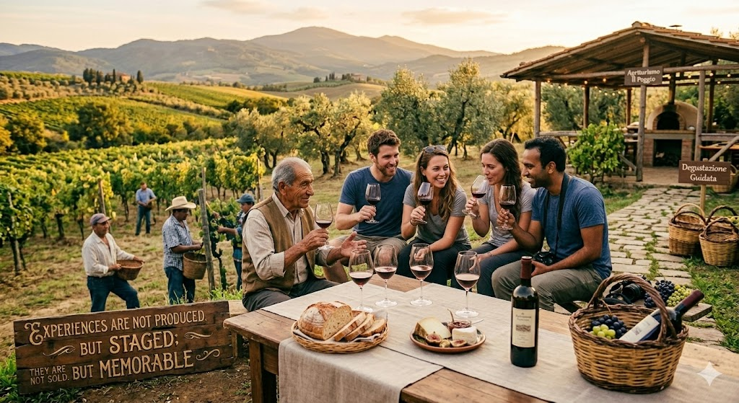
experiential tourism
Connecting with a place, its culture and people
Not just visiting, but “living” the destination
Immersion in local life and traditions
Active participation in activities at different levels: physical, sensory, and emotional
Emotional involvement for lasting memories
Experiences are not produced, but staged; they are not sold, but memorable
(Pine, Gilmore, 2000)
Notes:
The key concept put forward by the authors is that experiences are not ‘produced’ like material goods, nor are they ‘delivered’ like simple services, but are staged (staged) to create an emotional and memorable impact on the customer.

Slide 23
Tourist experience: design
Key design elements:
Define the level of customer involvement
Involve the local community
Combine tradition and innovation: meetings between young people and older people
Connect the experience to the stories of places or people and communicate it through storytelling
Customise the offering to meet the demands of an ever-changing tourist
Offering choices to active and informed consumers
Notes:
Define the level of customer involvement
First of all, we need to decide how actively tourists will participate in the experience.
Will they simply observe, or will they actively take part in the activity?
Experiential tourism usually involves a higher level of participation – for example learning a craft, preparing traditional food, or taking part in local practices.
Involve the local community
The designer should create opportunities for interaction between visitors and the local community.
This may involve collaborating with local residents, associations, or small producers to develop activities that allow visitors to experience everyday life, traditions, and local knowledge.
The goal is to ensure that the experience is authentic, respectful, and beneficial for the community.
Combine tradition and innovation
Design activities that allow traditional knowledge and practices to be shared and reinterpreted in a contemporary way, for example by creating opportunities for exchange between older and younger members of the community.
Possible examples
1️. Reinterpreted traditional craft workshop
An older artisan teaches a traditional technique (for example weaving, ceramics, or woodwork), while a young designer shows how this technique can be applied to contemporary objects.
tradition = craft technique
innovation = new uses, contemporary design
2️. Intergenerational gastronomic experience
An older member of the community teaches a traditional recipe, while a young chef proposes a more modern reinterpretation of the dish.
tradition = recipe, local ingredients
innovation = contemporary presentation or variation
3. Local storytelling using digital tools
Older residents share stories and memories of the place, while younger participants help transform them into short videos, podcasts, or digital maps.
tradition = oral memory
innovation = digital format
Connect the experience to the stories of places or people and communicate it through storytelling
Experiences are often more memorable when they are connected to the stories of the place / persons. Storytelling helps communicate this identity in an engaging and authentic way.
Experience: traditional bread cooking workshop
Story: The tradition of preparing this bread for special occasions and its role in family life and local culture
Storytelling: the host shares personal memories, explains how the recipe has been passed down through generations, and talks about family traditions while cooking

Slide 24
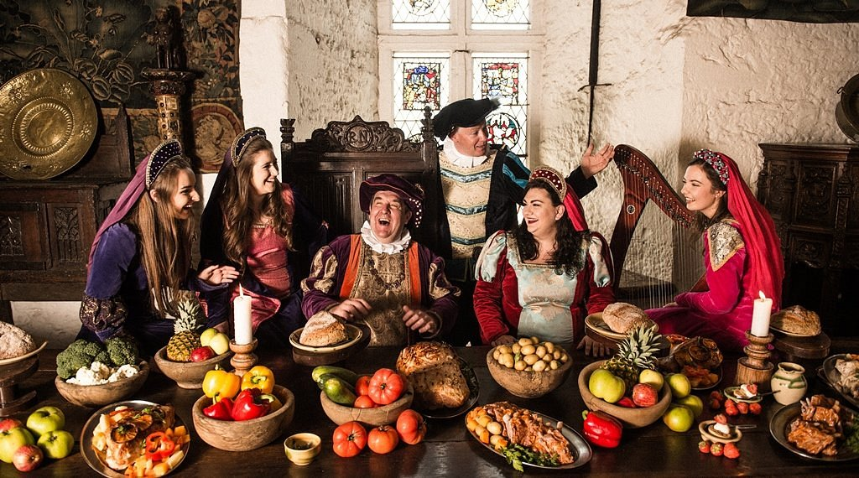
Tourist experience: design
Segmentation of demand from the point of view of experiences: what creates a positive experience for the target tourist
2. Construction of the experiential proposal: the design of the experience
Most important components of the offer for the target audience (attractions, services, activities)
Highly distinctive or unique components of the destination that characterise the identity of the area
Culture of hospitality and capacity for collaboration among local actors
Notes:
When we design the experience, we need to select activities, services and attractions that are interesting for our target group.
The experience should include elements that are unique to the place, such as local traditions, knowledge or products.
It is also important to involve local people, because collaboration between local actors helps create authentic and meaningful experiences.
Target group: lovers of the Middle Ages
Experience offered: participation in a costumed banquet featuring dishes inspired by medieval traditions that are still part of the local culinary heritage, accompanied by medieval music and dance
Unique elements of the place: the local medieval heritage that characterises the identity of the destination (for example castle, local history, traditions and stories connected to the medieval period)
Banquet venue: rooms within a local castle
Participation of local community members who recount stories set in the medieval period.

Slide 25
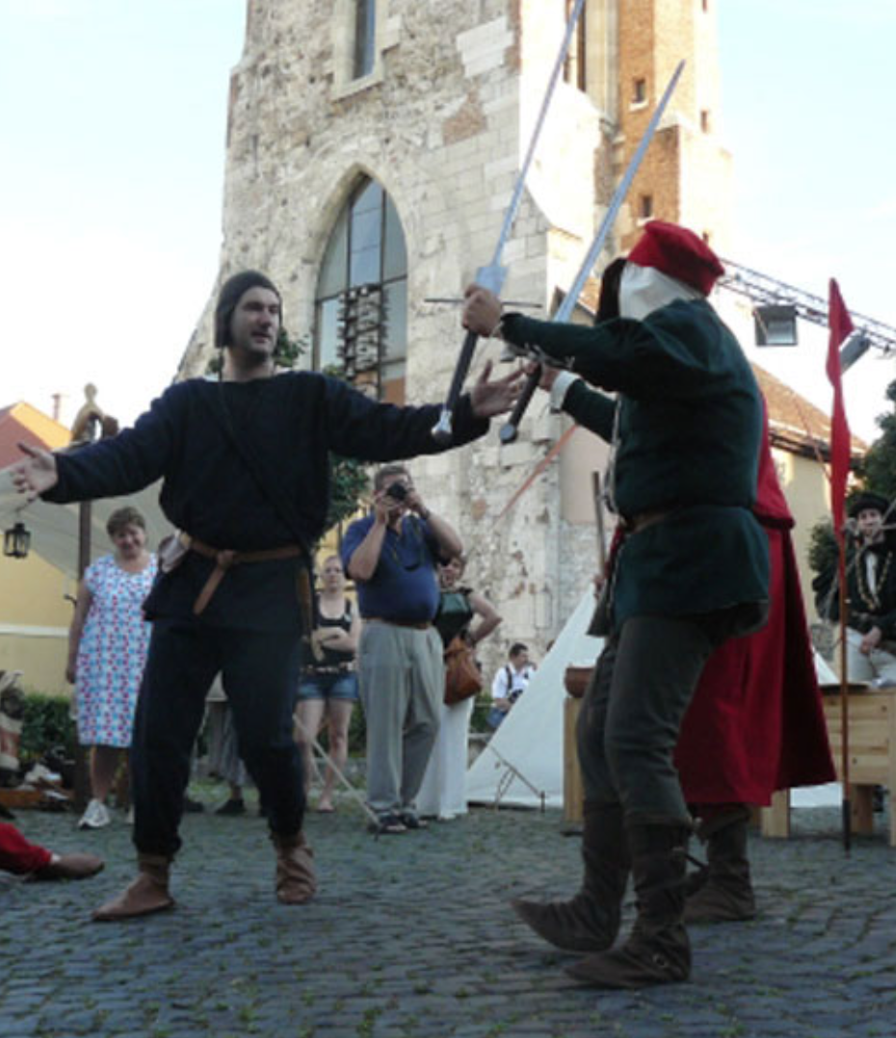
Tourist experience: design
Build the tourist experience around a clear and coherent theme
Consistency of each component with the theme and type of experience you want to offer
Preparation of memorable experiential product components for each target audience
Enthusiasm
Emotion
Involvement
Notes:
Theme:
the medieval period (12th–13th century) and the presence of the Knights Templar in the region
Experience components consistent with the theme:
reconstruction of aspects of medieval lifestyle
presentation of historical weapons used in the period
short course on basic sword-fighting techniques
These elements are coherent with the theme and actively involve visitors.
They help create emotions such as:
enthusiasm, involvement and a sense of immersion in the historical period.

Slide 26
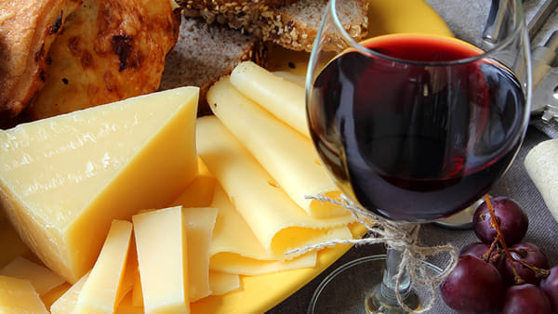
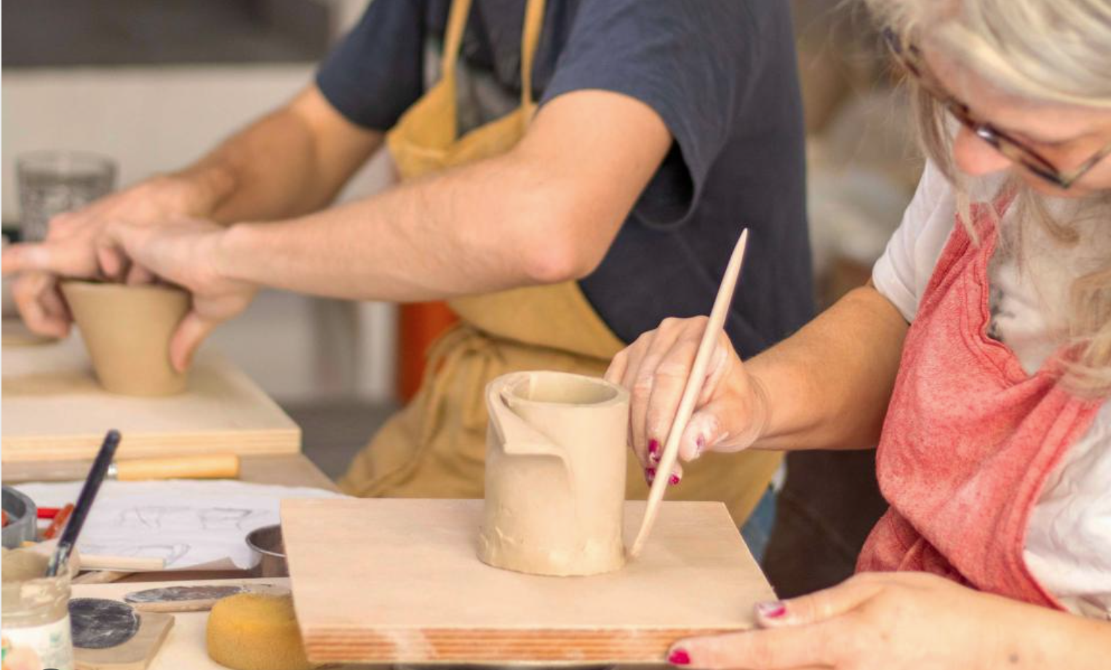
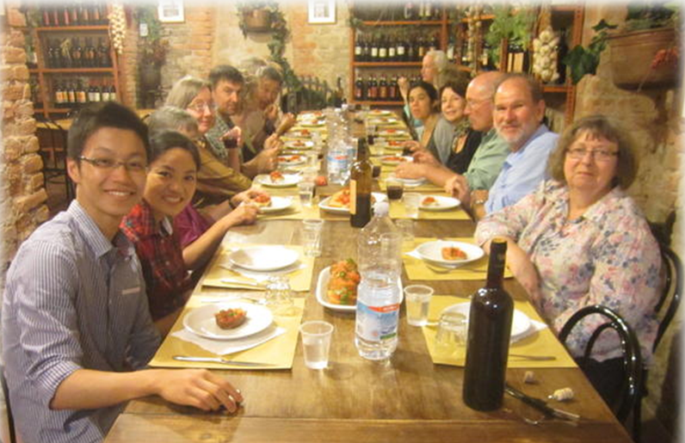
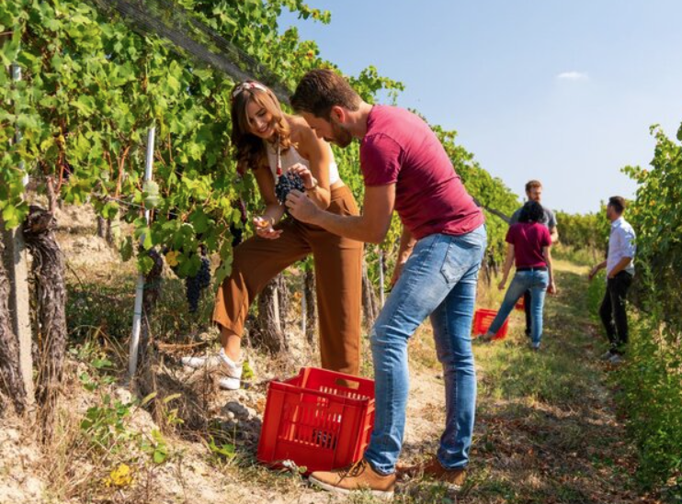
Tourist experience: design
Sensory experiences
Engage the five senses (sight, hearing, touch, smell and taste)
Cognitive experiences
Create experiences that stimulate the customer's creativity and their desire to learn
Relational experiences
Creating socio-cultural experiences that bring individuals into contact with other individuals and cultures
Physical experiences
Create engaging experiences involving physical activity, outdoor sports and adventures, but also participation in work activities
Notes:
Example:
Visitors smell herbs in the countryside, taste traditional dishes, and listen to local music.
Visitors learn by doing: they follow steps, solve small problems, and understand how a traditional pottery is made
Guests share a communal dinner with residents of the village.
Hiking through rural landscapes or participating in grape harvesting.

Slide 27
Tourist experience: design
6. Designing the experience delivery system
The delivery system is the organized way in which all human and physical elements involved in the relationship with the customer work together to provide a tourism service with specific characteristics and consistent quality.
Material and technological components
Front-line staff
Customer (Prosumer)
Notes:
Physical and Technological Resources
Facilities, equipment, and technologies used to provide the service.
Front-line Staff
Employees who interact directly with tourists.
Customer (Prosumer)
The tourist actively participates in the experience.
Example: Ceramic workshop
Material components:
workspace, clay, tools, wheel, kiln (oven for ceramics)
Front-line staff:
artisan guiding the activity and interacting with visitors
Customer (prosumer):
visitors actively participate and create their own ceramic object

Slide 28
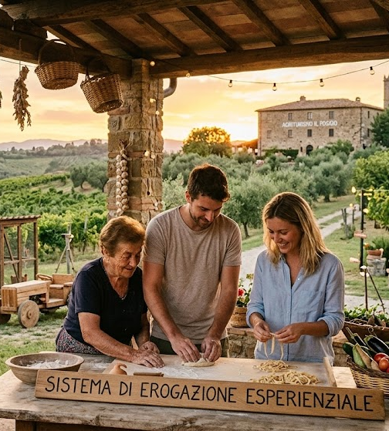
Tourist experience: design
Designing the experience delivery system
The delivery system must be designed to be consistent with the experience promised to the customer.
All elements of the delivery process should work together to reflect the value proposition.
The way the service is delivered can be as important as the service itself.
Notes:
In agri-tourism experience, the delivery system must reflect the value proposition of authenticity. Facilities, staff, activities, and customer participation all work together to create a genuine rural experience.
Physical resources
farmhouse in the countryside, outdoor terrace with a view, kitchen space for cooking activities, vineyards and rural landscape.
Front-line staff
local hosts or farmers who prepare a traditional dishes , explain local traditions, and guide the cooking experience.
Customer participation
guests actively participate in preparing food, learning recipes, and sharing the meal with the hosts.

Slide 29
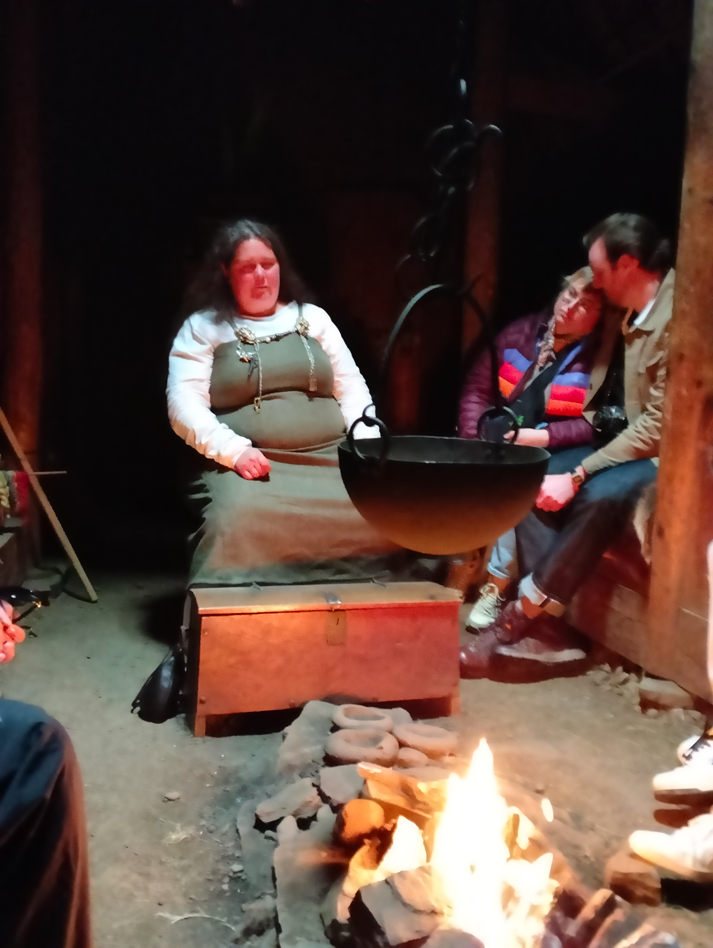
Tourist experience: design
7. Front-line staff
Staff behaviour (visible internal relations and relations with guests) strongly influences the customer's perception of the host facilities and the destination
Select, train and motivate a team that shares the objectives and has sensitivity, style and communication content consistent with the mission
Involve the staff of the various players in the supply system interested in producing the experience
Notes:
Example:
A passionate guide explaining local history / traditions can transform a simple visit into a memorable experience.

Slide 30
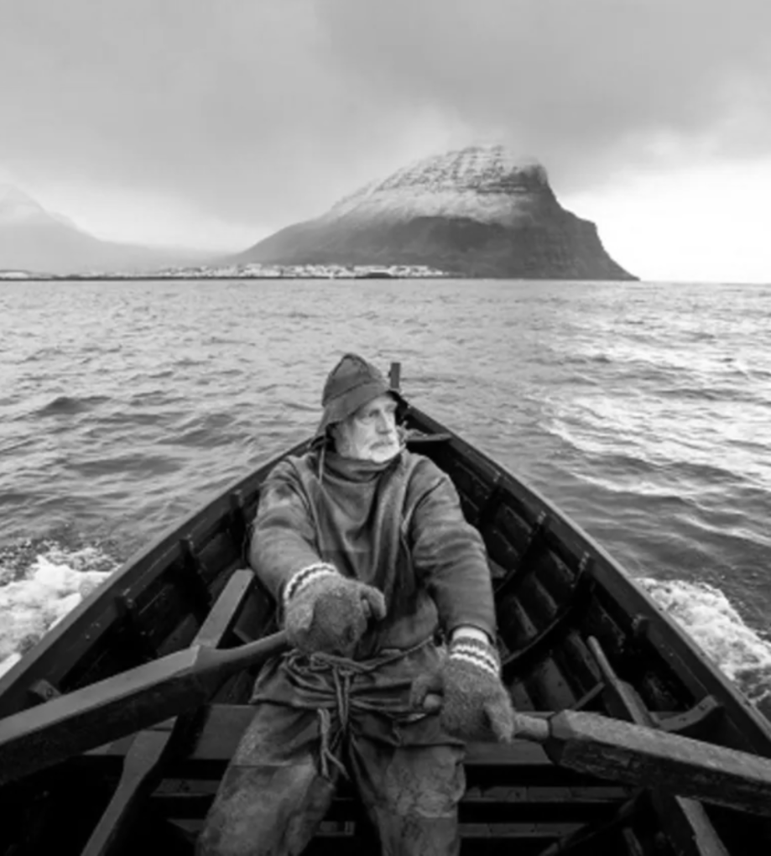
Tourist experience: design
Creation of the experiential communication strategy
Evocative and emotional communication based on storytelling and supporting content (photos, videos, augmented reality, etc.) with the aim of capturing the customer's attention and imagination.
Emotional stories
Representative events
Authentic testimonials
Physical and digital word of mouth
Notes:
Example 1 A short video showing a local artisan weaving or making pottery, with their personal story, can attract visitors who want to learn traditional skills.
Example 2 Photos and reels of a cooking experience with a local family, showing real moments of preparation and sharing food, can inspire tourists to book the experience.

Slide 31
Experiential product: communication and promotion
Objective: to attract and inspire guests interested in local culture and authentic experiences
Showcase the area and the community that lives there, with its lifestyle and traditions: stories of real people
Narrative style and tone
Storytelling and multimedia content
Using the web to present an engaging story based on visual and multimedia content
Designing Instagrammable experiences
Training and encouraging staff to tell authentic stories about the local area and the company
Notes:
Once we design the experience, we also need to think about how to communicate it in order to attract visitors.
Communication should not only give information, but also inspire visitors.
It is important to show the place, the people and the traditions behind the experience.
Stories are very useful because they help visitors understand why the experience is special.
Photos, videos and simple storytelling help visitors imagine the experience before arriving.
Authenticity is very important, especially in rural areas.
Visitors want to see real people and real stories.

Slide 32
Experiential product: sales channels
Difficulties for tourists and major travel distributors in finding information, booking and contracting activities and experiences available at the destination
Market for the sale of activities and experiences extremely fragmented among numerous small operators
Large travel distributors have yet to identify a business model that generates profits and simplifies the search and booking of desired experiences
Notes:
Experiences are often offered by many small local providers, especially if they’re located in marginal rural areas.
Because of this, it is sometimes difficult for visitors to find information or book activities.
This is why visibility and accessibility are important.
Even a very good experience may not attract visitors if it is difficult to find or book.
Large platforms are still trying to find the best way to make these experiences easy to find, easy to book and economically sustainable.

Slide 33
Experiential product: sales channels
Direct selling
Local incoming tour operators
Producers of activities and experiences
Tour operator
Indirect distribution channels
On-line Travel Agency
Specialised sales platforms
Notes:
Experiences can be sold through different channels.
Some are direct, for example through a website or direct contact.
Others are indirect, for example through tour operators or online platforms.
The important point is that visitors should easily understand where to find information and how to book the experience.

Slide 34

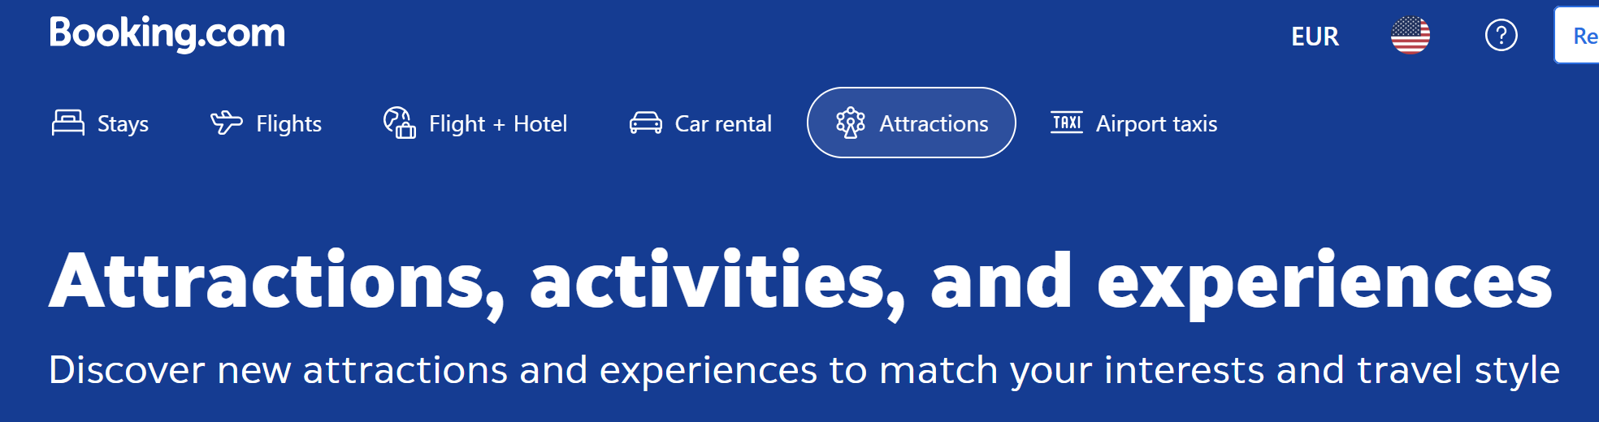

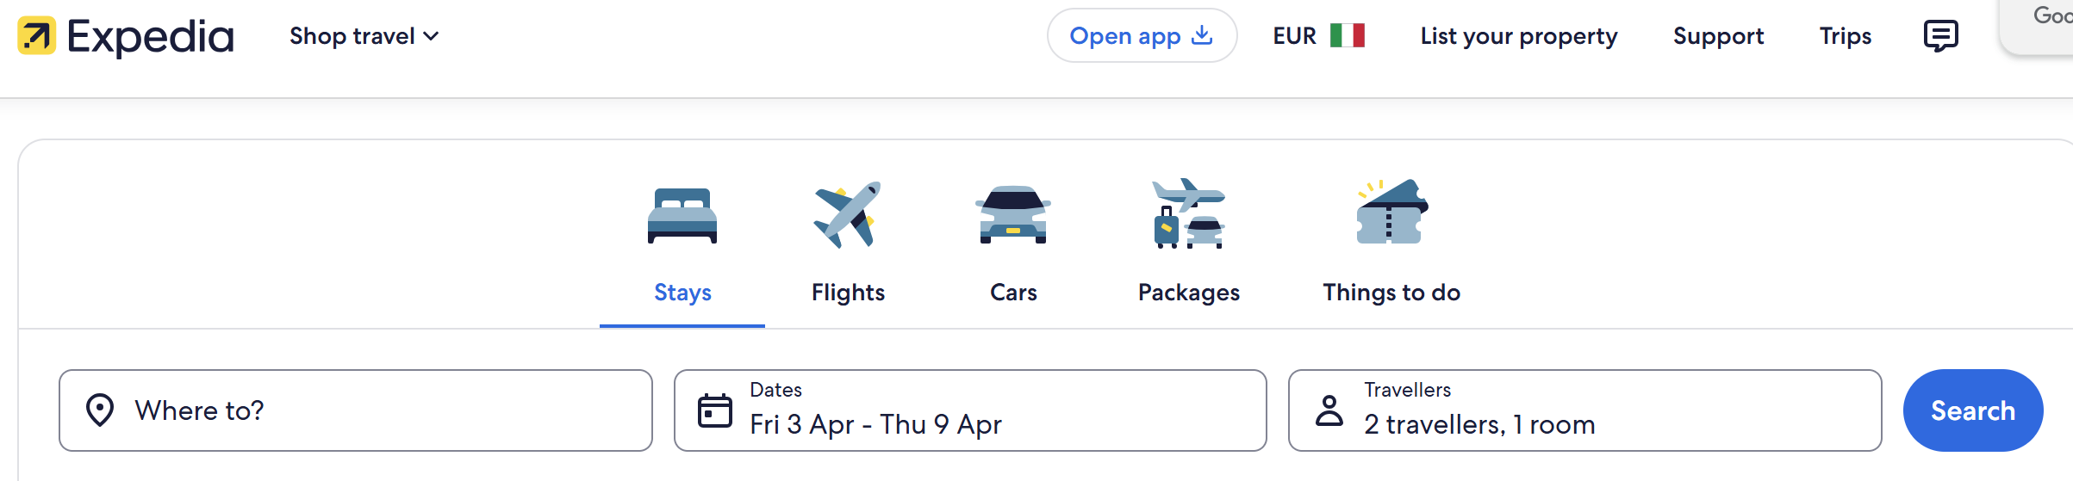
Experiential product: sales channels
Online Travel Agency
They work to inspire and assist tourists throughout their travel experience (Booking.com, Expedia, etc.)
They propose and sell activities and experiences that appeal to their target audience
They ensure reviews and ratings and interaction with social media
Notes:
Online platforms help visitors discover and book experiences.
They make experiences more visible, especially for international visitors.
They also include reviews, which help visitors feel more confident when choosing an activity.
For small rural providers, these platforms can help reach a wider audience.

Slide 35







Experiential product: sales channels
Specialised sales platforms:
GetYourGuide, Guide Me Right, Musement (TuiGroup), Civitatis, TrekkSoft, etc.
Notes:
There are also online platforms that specialise in selling activities and experiences.
These platforms help visitors discover experiences and book them easily.
They are useful especially for small local providers, because they increase visibility and make the booking process simpler.
Some examples are GetYourGuide, Viator, Airbnb Experiences, Civitatis and others.
Visitors often use these platforms when planning their trips.

Slide 36
Production process of a tourism product
Design
specifications
Product 1
Communication
Distribution & sales
Target 1
Design
B2C
Requirements
Segmentation Profiling Targeting
Design
specifications
Product
2
Requirements
Target 2
B2B
Requirements
Design
specifications
Target …
Product…

Slide 37
#ASenseofEU - Training Mobility in Italy
Co-funded by the European Union.
Grant Agreement No. 2024-1-IS01-KA220-ADU-000251000
The European Commission support for the production of this publication does not constitute an endorsement of the contents which reflects the views only of the authors, and the Commission cannot be held responsible for any use which may be made of the information contained therein.
Instructions for developing participants’ tourism product project
Gubbio (Umbria - iTALY) | 23–27 March 2026

Slide 38
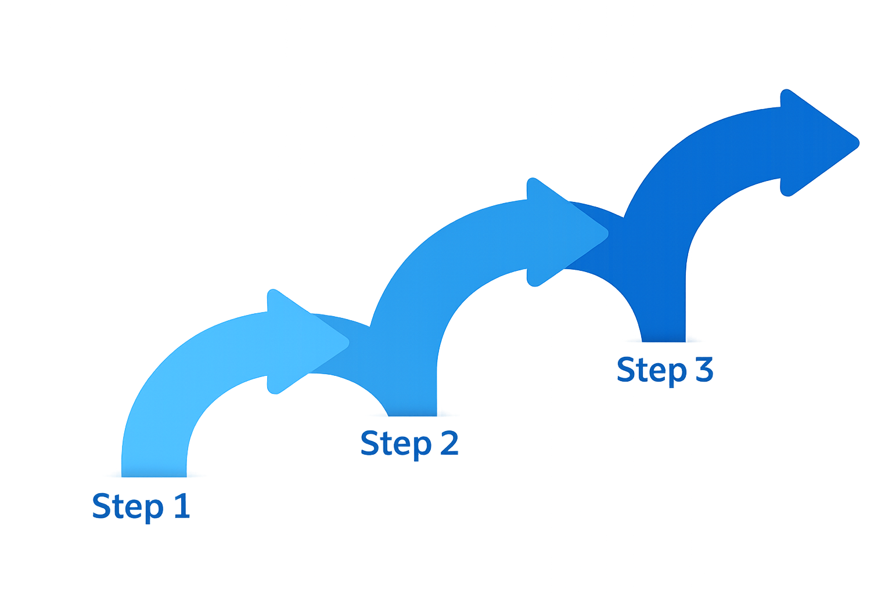
Developing your tourism product: a progressive process
During this training, you will progressively develop
your ICH-based tourism product.
You will do this by:
applying the concepts presented in this session
integrating the knowledge introduced in the upcoming thematic modules
using the tools and examples provided throughout the training
Your tourism product will evolve step by step.

Slide 39
What does developing a tourism product involve?
Developing a tourism product means progressively defining:
Who is your target visitor?
What are the primary and secondary motivations, and what are the key requests and expectations of your target group?
What experience will you offer?
Which ICH element is at its core?
Which activities are included?
Which services are needed?
Which local stakeholders should be involved as partners?
How will it be communicated and distributed?
You will refine these elements step by step.

Slide 40
How each module will support your project
The Sense of Place module will help you understand the identity and unique characteristics of your place and how these can make it attractive to visitors.
The Intangible Cultural Heritage module will help you identify cultural traditions, practices, and knowledge that can become meaningful tourism experiences.
The Intergenerational Learning module will help you understand how knowledge, traditions, and skills are transmitted between generations and how these exchanges can strengthen cultural heritage and enrich tourism experiences.

Slide 41
How each module will support your project
The Community Engagement module will help you understand how local people, organisations, and stakeholders can contribute to and support tourism experiences.
The Digitalisation module will help you explore how digital tools can document, communicate, and enhance your tourism product.

Slide 42
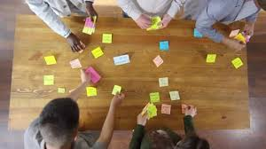
Your role during the training
Throughout the week:
• Reflect continuously on your tourism product idea
• Take notes during each module
• Identify elements that can strengthen your concept
• Be ready to adjust and refine your idea
Your tourism product will evolve step by step.
Enjoy your work!

