Slide 1

#ASenseofEU - Training Mobility in Italy
Co-funded by the European Union.
Grant Agreement No. 2024-1-IS01-KA220-ADU-000251000
The European Commission support for the production of this publication does not constitute an endorsement of the contents which reflects the views only of the authors, and the Commission cannot be held responsible for any use which may be made of the information contained therein.
Intangible Cultural Heritage-based tourism in remote and rural areas
Best practices
Gubbio (Umbria - iTALY) | 23–27 March 2026
Notes:
Today I will introduce the topic of tourism based on intangible cultural heritage, with a particular focus on rural and remote areas.
During this session, we will explore how tourism has evolved from a traditional model focused on places and attractions to a model centered on experiences, motivations, and cultural identity.
We will also examine how tourism products and experiences are designed, produced, and communicated, especially in contexts where intangible cultural heritage represents a key resource.

Slide 2

From Intangible Cultural Heritage to Tourism Products - Analysing Three Best Practice Examples
Why analyse best practice examples?
Best practices help us understand:
how cultural heritage can become a tourism experience
how ideas are translated into structured tourism products
how local identity can create value for visitors
They are sources of inspiration.

Slide 3
From Intangible Cultural Heritage to Tourism Products - Analysing Three Best Practice Examples
What should you observe?
While listening to the examples, pay attention to:
• What is the core cultural element?
• What type of experience is offered?
• Who is the target visitor?
• What activities are included?
• Which services support the experience?
• Which local stakeholders are involved?
• How is the experience communicated?

Slide 4
From Intangible Cultural Heritage to Tourism Products - Analysing Three Best Practice Examples
Look beyond the surface
Do not focus only on:
• what they do
Focus on:
• how the experience is structured
• how the cultural element is transformed into value
• how different actors collaborate
• how the experience is made coherent

Slide 5
From Intangible Cultural Heritage to Tourism Products - Analysing Three Best Practice Examples
In this session, we will analyse three best practice examples that demonstrate how rural intangible cultural heritage (ICH) can be transformed into meaningful tourism experiences.
The three cases represent different approaches:
A village-based narrative identity model
A living traditional practice transformed into experiential tourism
A digital platform structuring rural cultural experiences

Slide 6
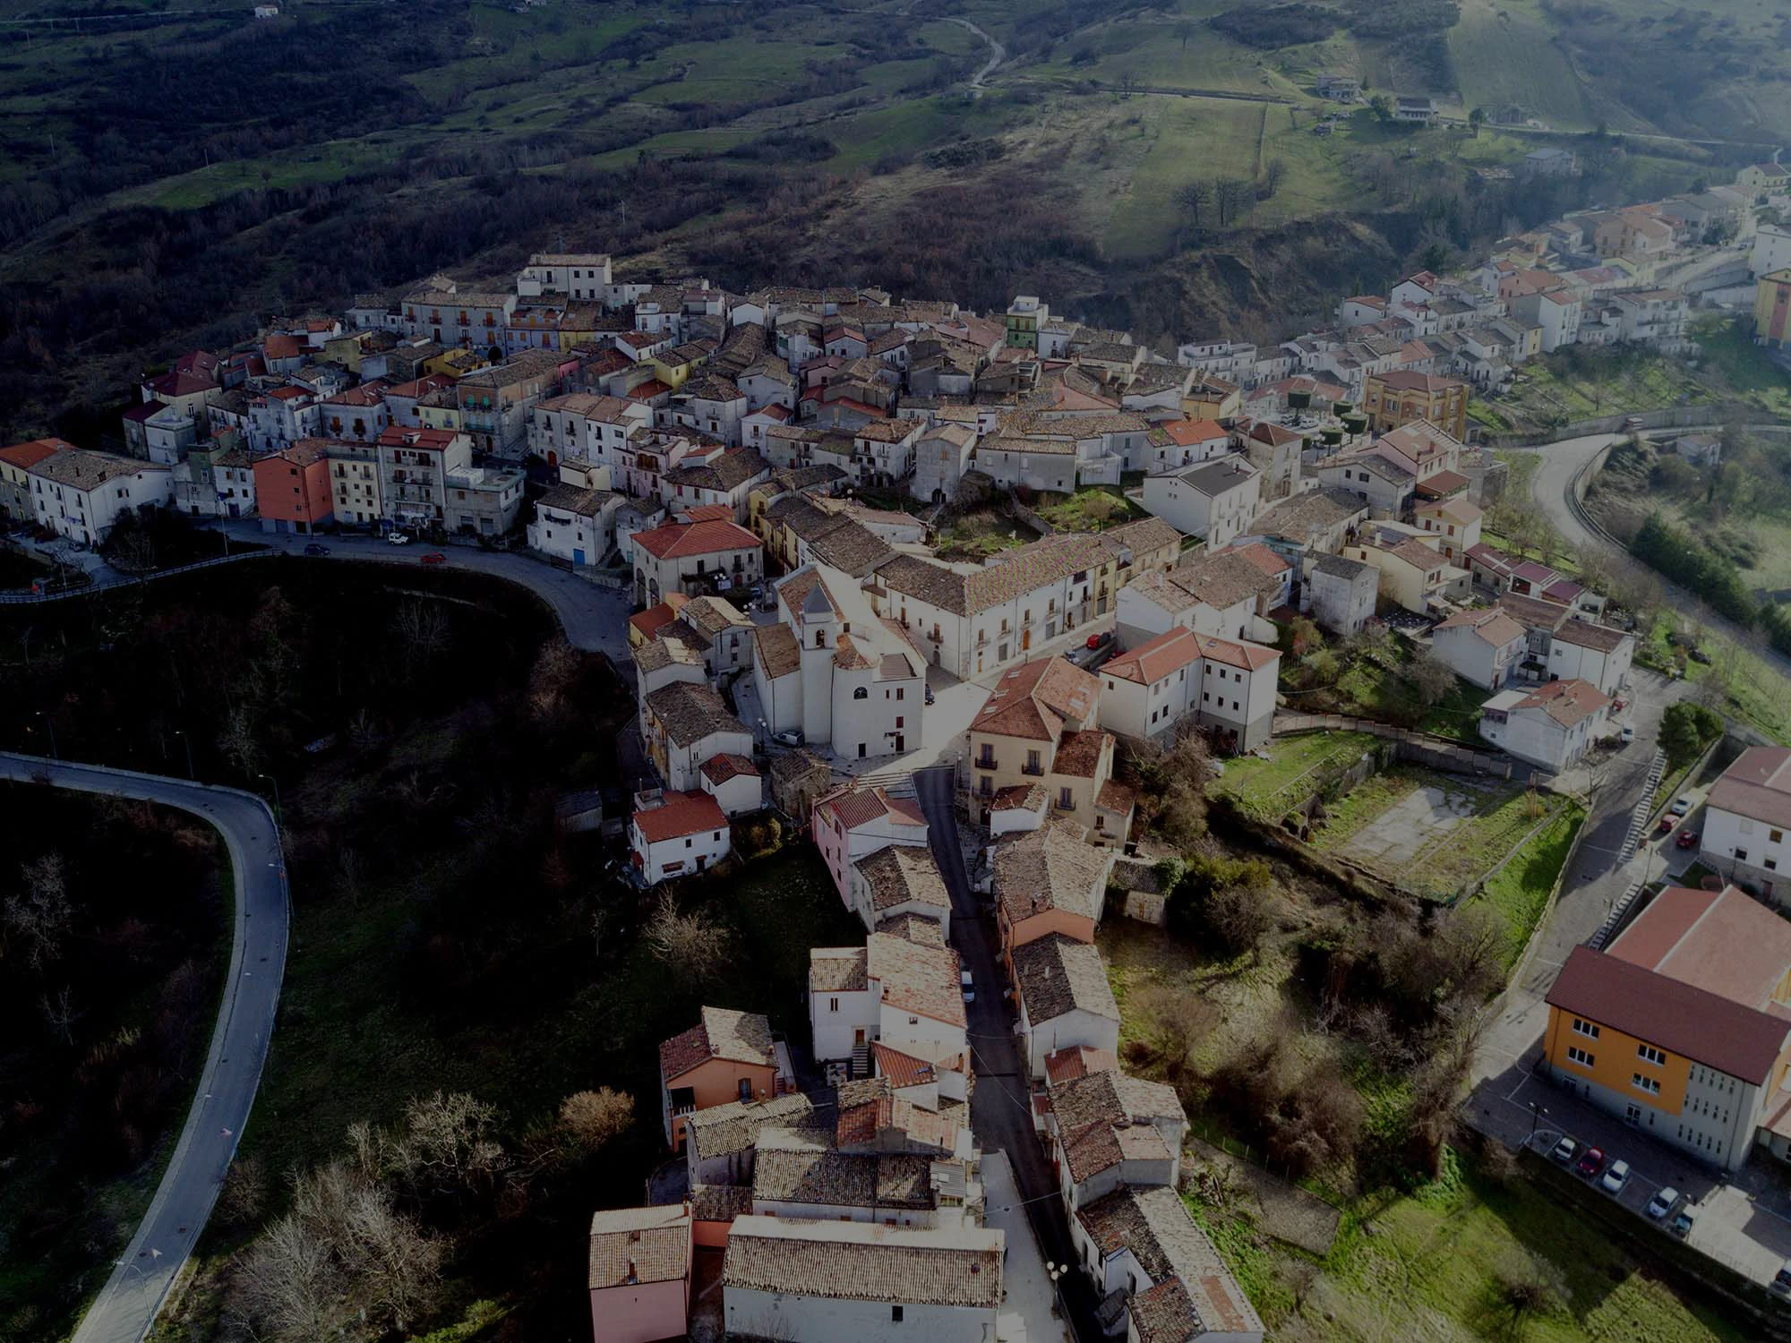
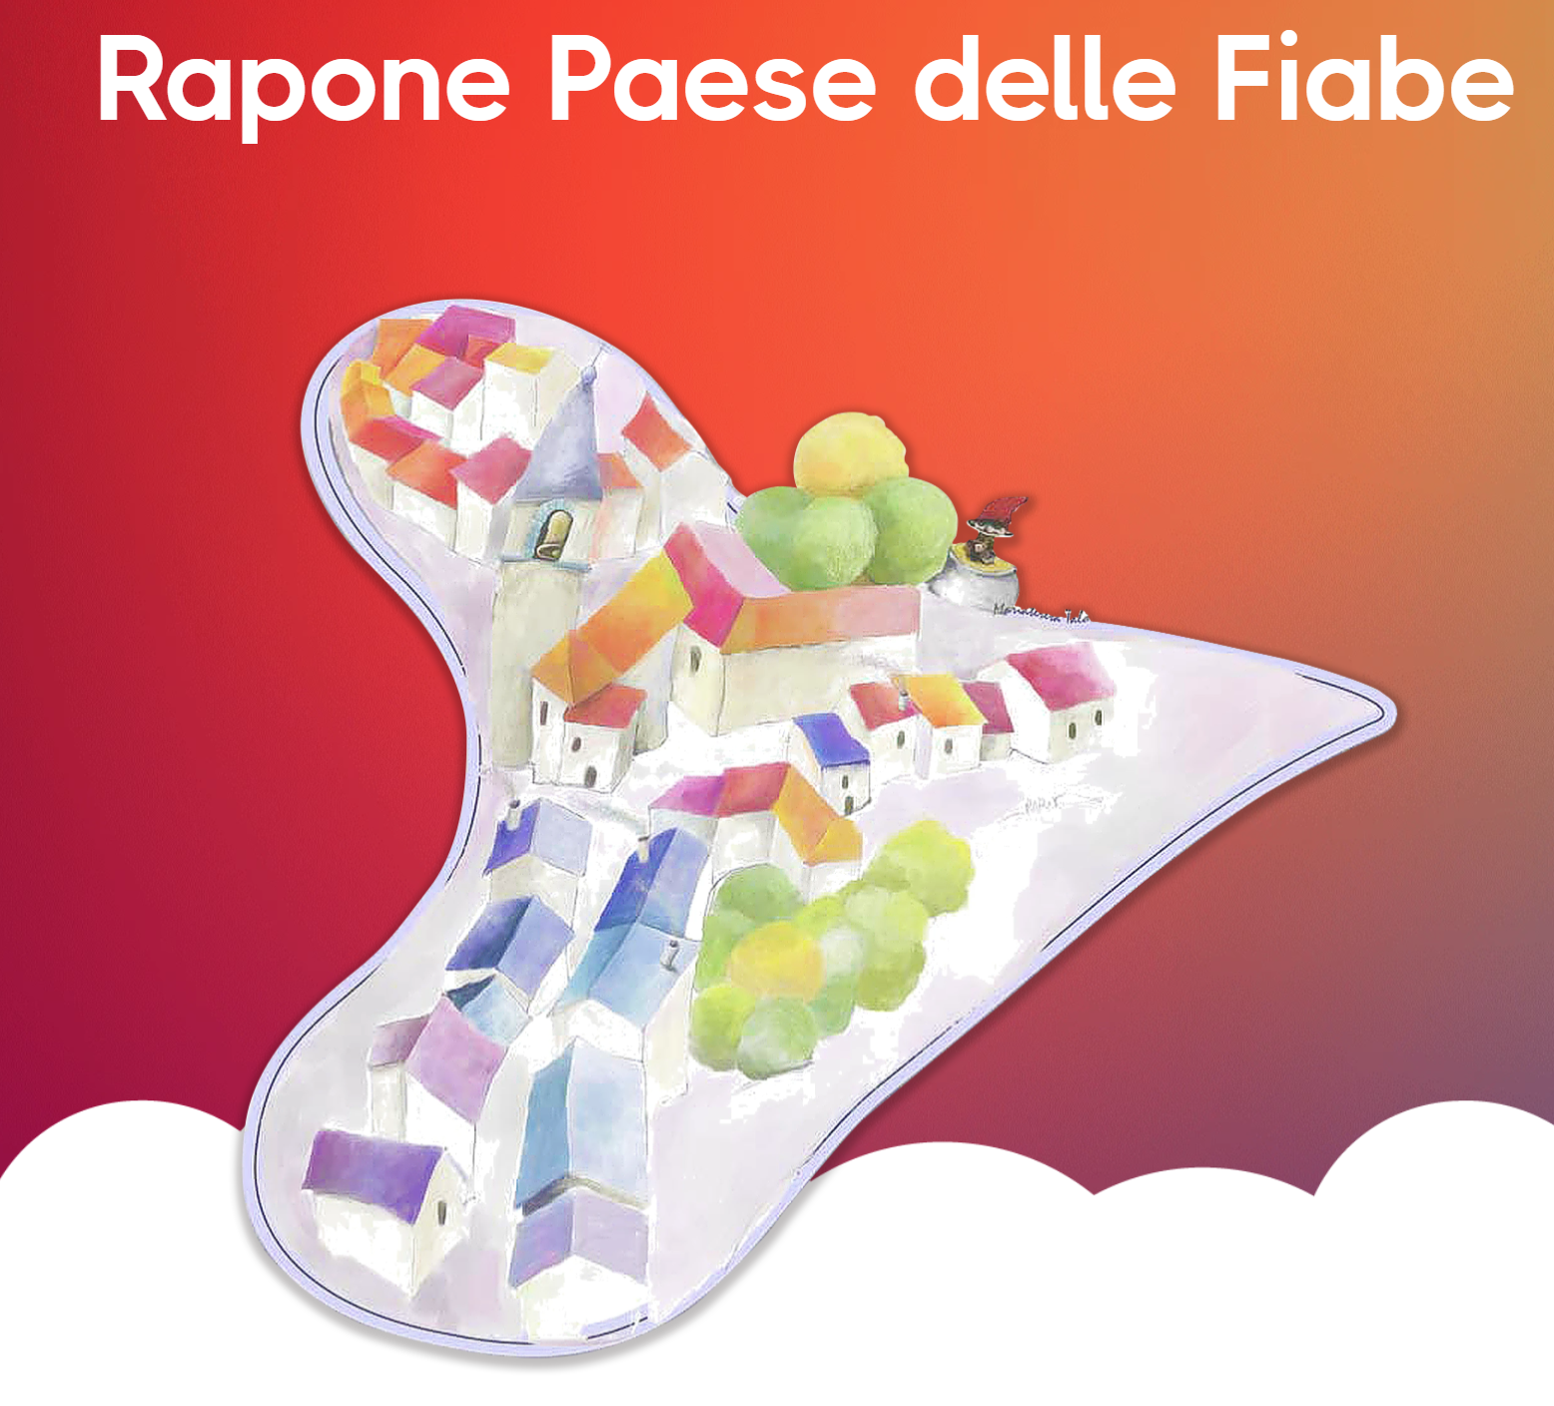
Best practice 1: Rapone – The Fairy Tale Village
Location: Rapone, Basilicata, Southern Italy
Core Intangible Cultural Heritage (ICH): Oral storytelling tradition
Rapone is a small rural village that has built its identity and tourism strategy around its traditional oral storytelling heritage.
The initiative transformed local folklore into immersive cultural experiences.
https://www.raponepaesedellefiabe.it/en/home.html

Slide 7
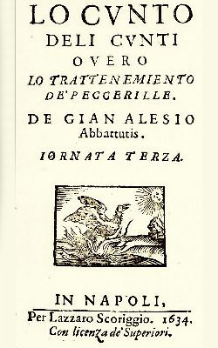
The Cultural Background: Lo Cunto de li Cunti
Lo Cunto de li Cunti (The Tale of Tales) written by Giovan Battista Basile (1634–1636)
It is considered the first major European collection of fairy tales and a foundational work of fairy tale literature.
Many well-known fairy tales originate from this work, including early versions of: Cinderella, Sleeping Beauty, Rapunzel later adapted by: Perrault, Andersen, and the Brothers Grimm.
The stories collected by Basile were rooted in Southern Italy’s oral tradition, including areas of Basilicata and Rapone.

Slide 8
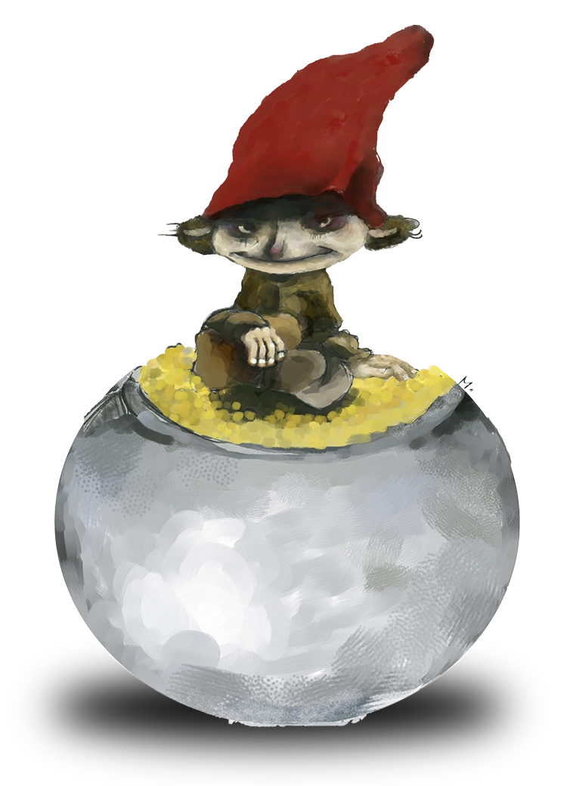
The Intangible Cultural Heritage Element
Core ICH Element:
Oral storytelling tradition
Local folklore characters
Intergenerational transmission of stories
Collective memory and imagination
Rapone does not preserve monuments - it preserves living narratives.
Storytelling becomes the foundation of place identity and tourism development.
Fairy-tale character of the goblin/folklore sprite type. It could resemble local folklore figures such as the Scazzamauriedd, a character from Southern Italian popular tradition often described as a small mischievous spirit.

Slide 9
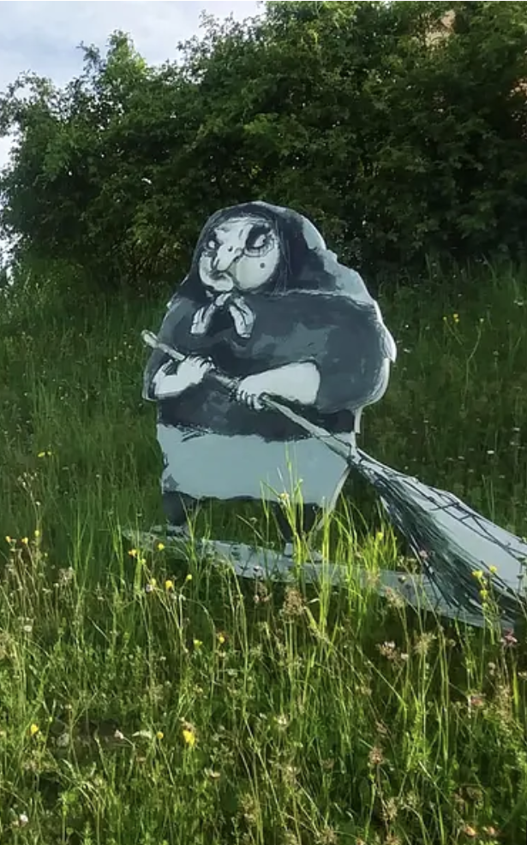
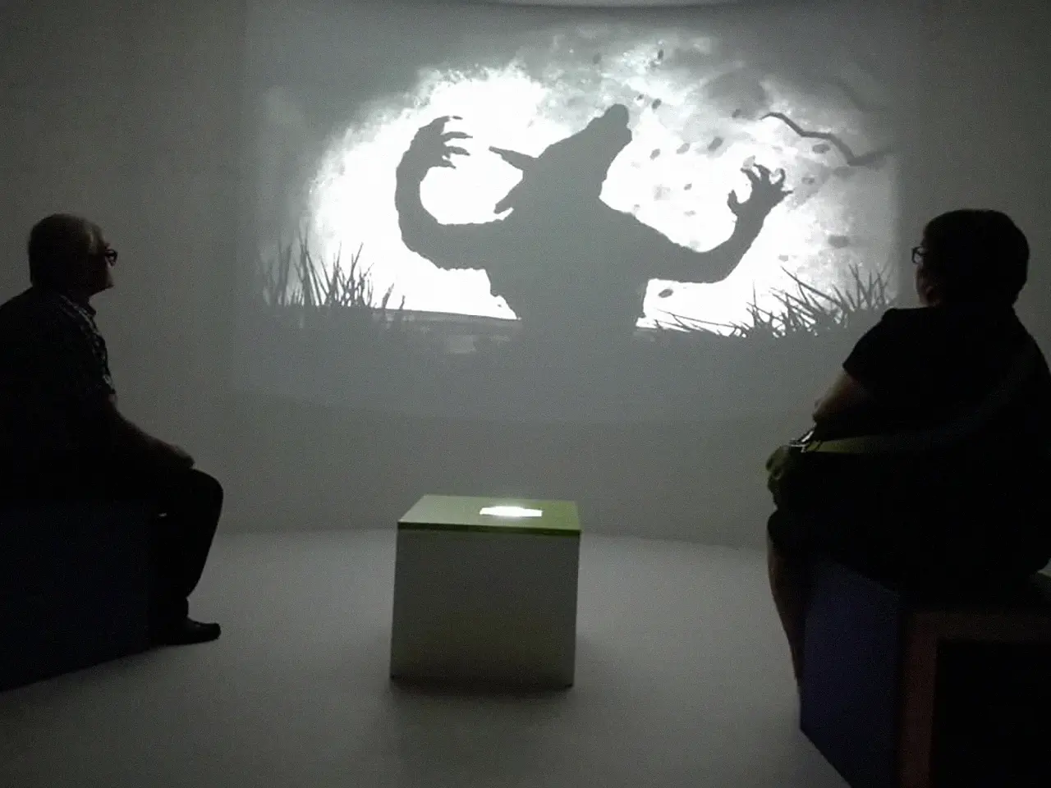
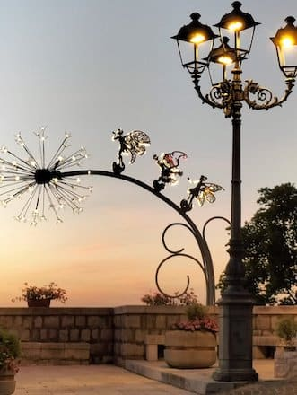
How the Cultural Element is Transformed into a Tourism Product
Rapone has structured its storytelling heritage into a coherent tourism experience:
The Path of the Five Fairy Tales: an urban trail with multimedia installations featuring iconic local characters
C.E.R.A. una volta (Center for Ethnographic Research and Audiovisuals): a multimedia museum preserving Rapone’s intangible heritage through digital storytelling, immersive installations, and audiovisual testimonies.
The Dandelion of Wishes: an interactive installation where visitors can express wishes and connect imagination with personal reflection.
In Masciar
The local witch

Slide 10
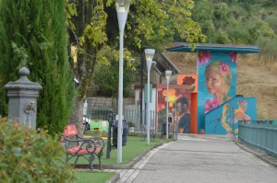
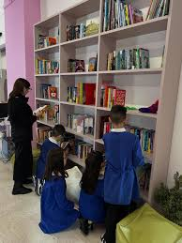
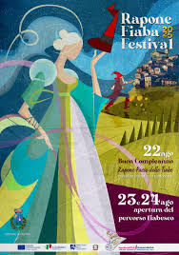
How the Cultural Element is Transformed into a Tourism Product
The Princesses’ Boulevard: a symbolic path celebrating female figures from fairy tales through visual storytelling and design.
The mural “From Petrosinella to Rapunzel”: a large artwork that traces the evolution of a fairy tale heroine from Basile’s Petrosinella to the Brothers Grimm’s Rapunzel, and finally to the Disney adaptation.
The Fairy Tale Library: a creative reading space offering pop-up books, sensory books, and interactive resources for children, educators, and families.
Annual festivals (August and December)
https://www.facebook.com/watch/?v=1130899184662066

Slide 11
Tourism Product Components
Component | Application in Rapone
Core attraction | Fairy tale storytelling tradition
Experience | Themed village exploration
Activities | Guided tours, festivals, storytelling, cultural events
Supporting services | Local hospitality, events organisation
Image | Magical village / narrative identity
Communication and Distribution | Online promotion (https://www.familygo.eu/vacanze-con-bambini/viaggi/basilicata/rapone-paese-delle-fiabe/ ), specialised travel platforms (https://www.raduratrekking.com/borghintrek-rapone-pz-il-paese-delle-fiabe/ )
Rapone transforms cultural memory into a structured and marketable tourism experience.
Notes:
FamilyGO (https://www.familygo.eu/) is an Italian online magazine, established in 2009, specialising in family travel. It provides travel ideas, child-friendly hotels, events, museums and family-oriented itineraries in Italy and abroad, promoting high-quality accommodation and collaborating with tourism boards.

Slide 12
Why is Rapone a Best Practice?
It revitalises intangible cultural heritage
It strengthens local identity and sense of place
It involves the local community and artists
It combines tradition and digital tools
It creates sustainable rural tourism
It is adaptable and replicable for other small villages
Rapone shows how intangible cultural heritage can become the core of a coherent and meaningful tourism product.

Slide 13
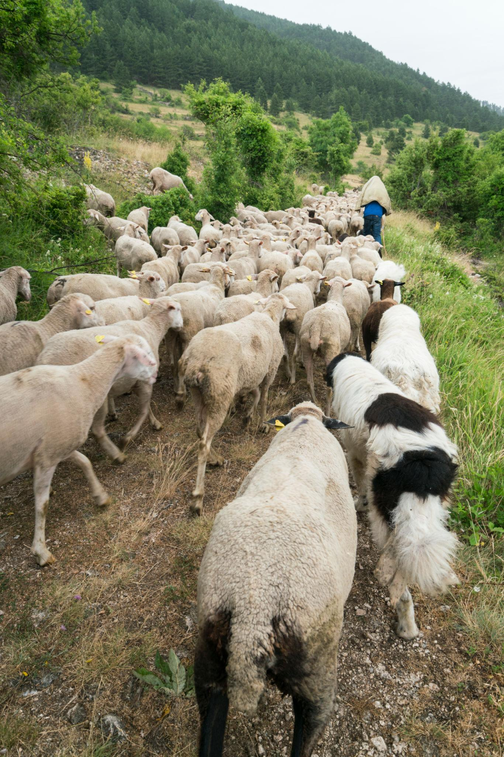
Best practice 2: Transhumance
Type: Living pastoral tradition
Recognition: Inscribed on UNESCO’s Representative List of Intangible Cultural Heritage (2019 - 2023) – Multinational (Austria, Greece - Italy Albania, Andorra, Croazia, France, Luxembourg, Romania, Spain)
Italian geographical areas involved:
Alps
Central-southern regions
Transhumance is the traditional, seasonal movement of livestock - mainly sheep and cattle - between lowland winter pastures and mountain summer grazing areas, along ancient grassy routes known as tratturi. https://www.youtube.com/watch?v=e_35vNXgtsE
Notes:
In Iceland something like transumance exists and it’s called smölun and réttir. In Sweden: Summer farming at fäbod and seter

Slide 14
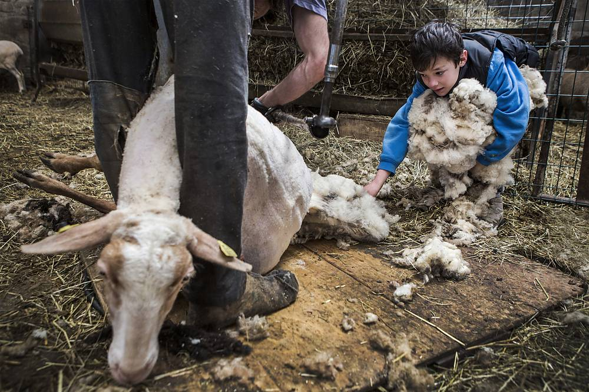
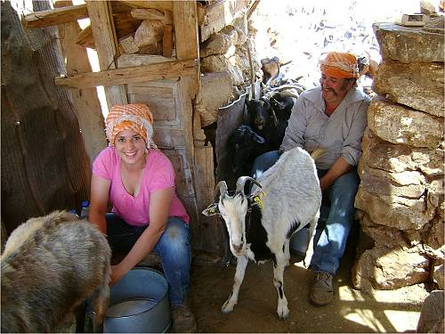
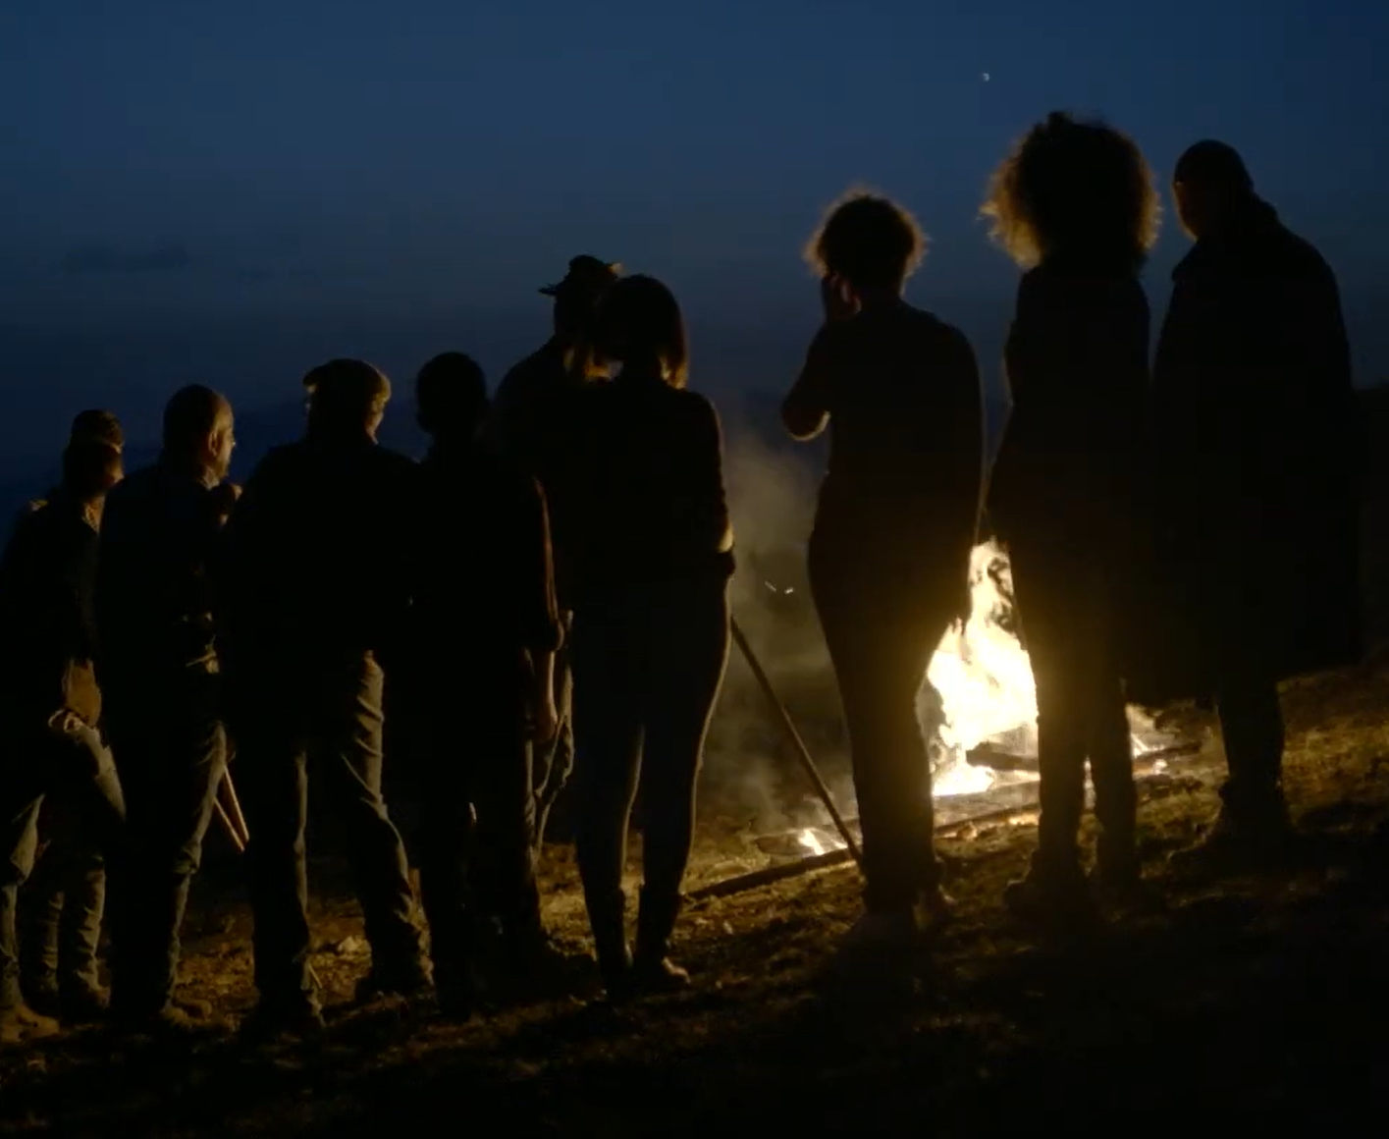
The Intangible Cultural Heritage Element
Core ICH components:
Traditional pastoral knowledge
Seasonal rituals and practices
Animal husbandry techniques
Landscape management skills
Oral knowledge transmitted across generations
Transhumance is not just movement of animals - it is a cultural system linking people, landscape, and identity.

Slide 15
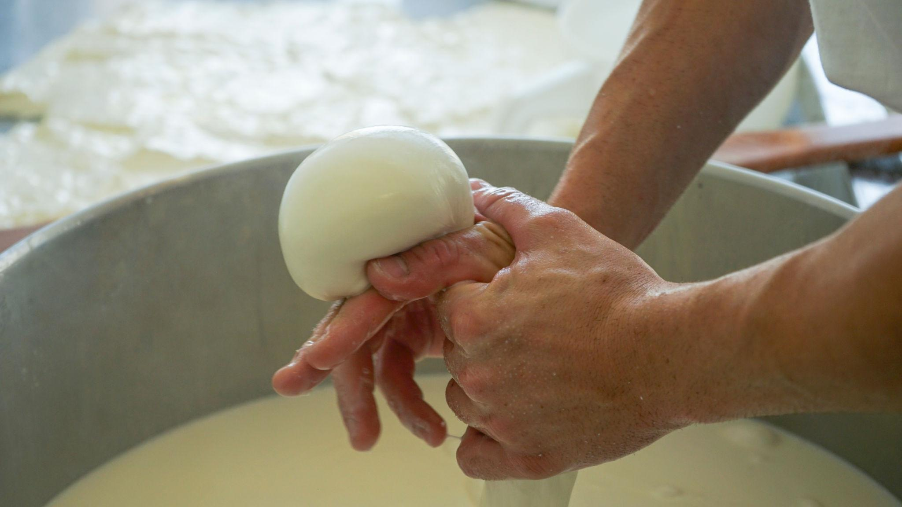
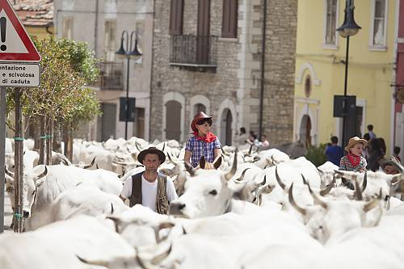
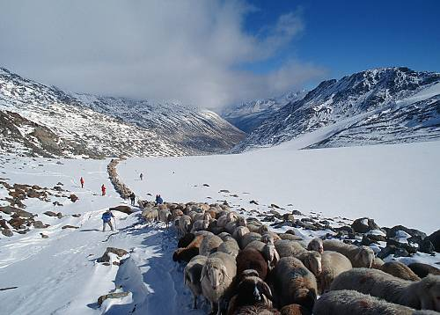
Cultural and Historical Significance
For centuries, transhumance shaped:
Rural economies
Settlement patterns
Food traditions (cheese, dairy products)
Social relationships between mountain and lowland communities
The tratturi are cultural corridors that connect territories.
Transhumance represents:
✔ Sustainability
✔ Adaptation to environment
✔ Human–nature balance

Slide 16
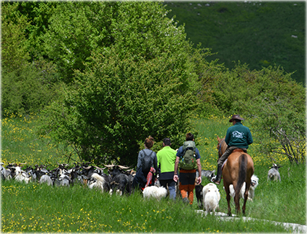
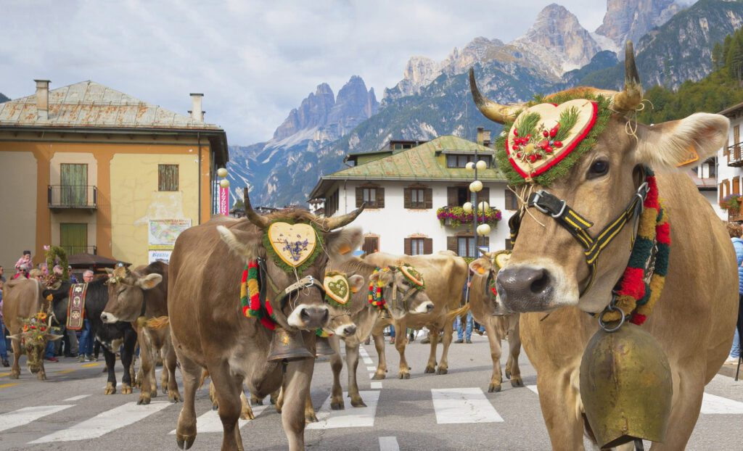
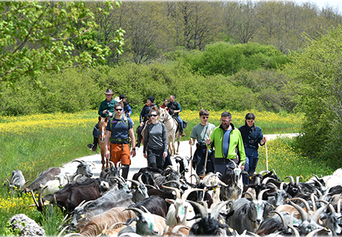
Transformation into a Tourism Experience
Today, transhumance has been reinterpreted as:
Guided walking routes along ancient tratturi
Experiential activities
Educational tourism for schools
Slow tourism and nature-based tourism
Cultural festivals linked to pastoral traditions
Type of experience offered:
Participatory
Immersive
Educational
Slow and sustainable

Slide 17
Tourism Product Components
Component | Application in Transhumance
Core attraction | Living pastoral migration tradition
Experience | Walking with shepherds / rural immersion
Activities | Herding, cheese-making workshops
Supporting services | Rural accommodation, local guides
Image | Authentic, slow, sustainable tourism
Communication and Distribution | Online promotion; online travel agency and specialised travel platforms
https://www.schnalstal.com/en/your-adventure/your-adventure-in-summer/transhumance-italy
https://www.farmexperience.it/en/lazio/transhumance-traveling-with-tradition/
The traditional practice becomes a structured tourism experience while maintaining authenticity.

Slide 18
Why is Transhumance a Best Practice?
It transforms a living tradition into experiential tourism
It strengthens rural identity and landscape value
It supports local shepherds and rural communities
It promotes sustainable and slow tourism
It connects cultural heritage with environmental awareness
Transhumance demonstrates how a traditional practice can generate tourism value without losing its cultural meaning.

Slide 19
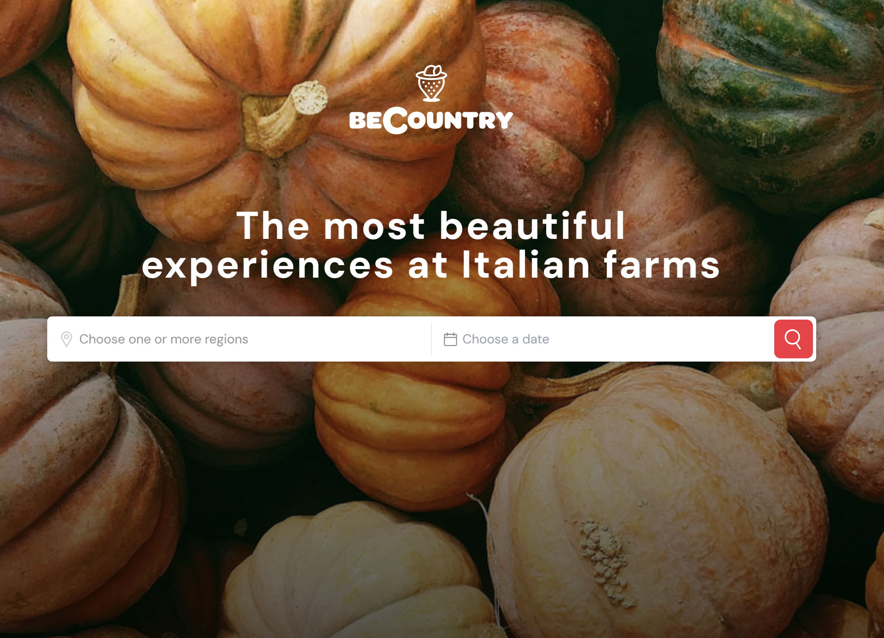
Best practice 3: BeCountry
Type: Digital platform for rural experiences
Focus: Promotion and structuring of authentic agricultural and cultural experiences
BeCountry is an Italian platform that connects visitors with farms offering rural experiential activities.
It transforms rural practices into structured, bookable tourism products.

Slide 20
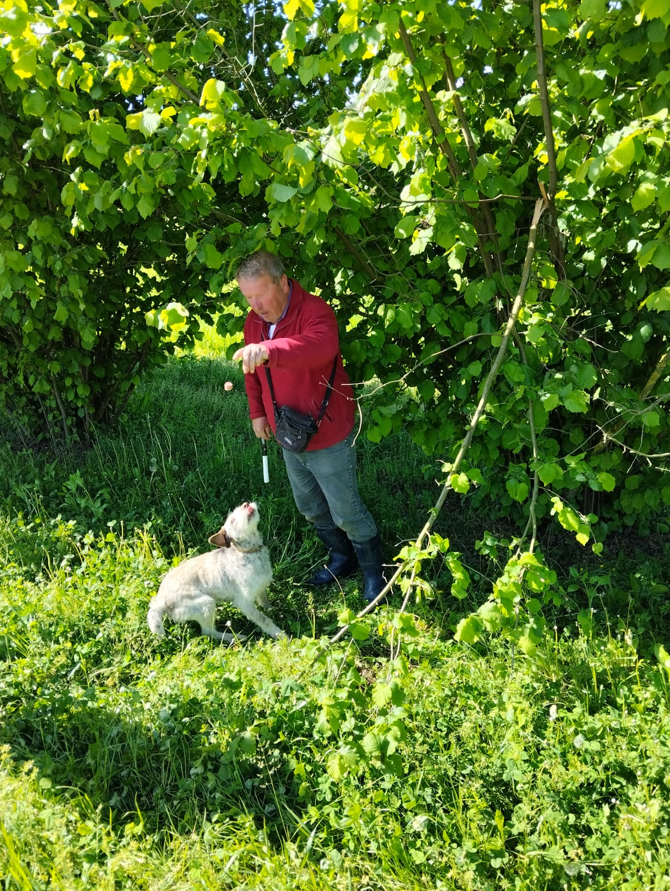
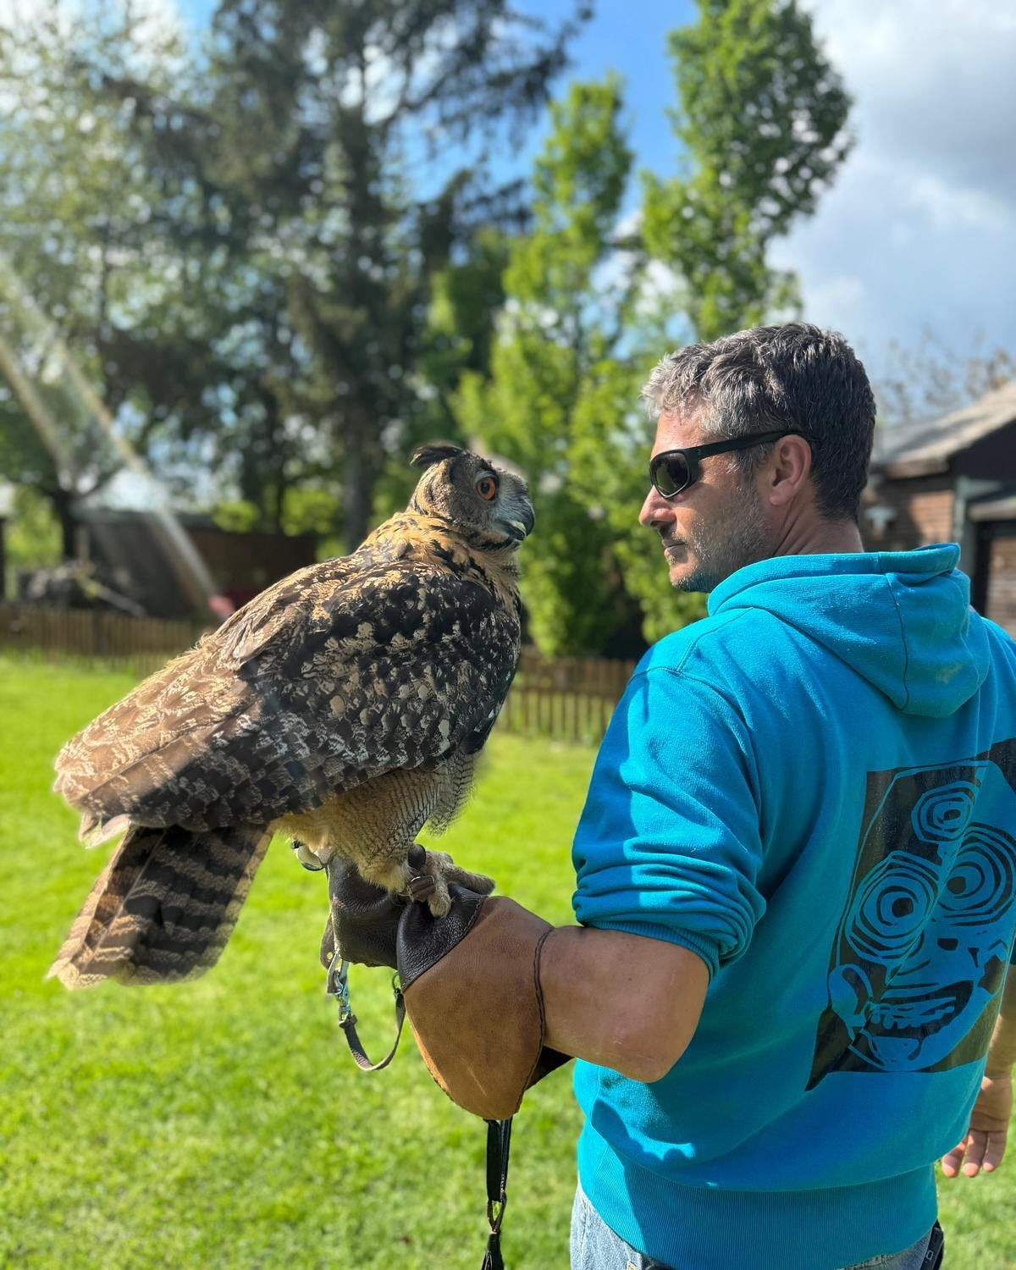
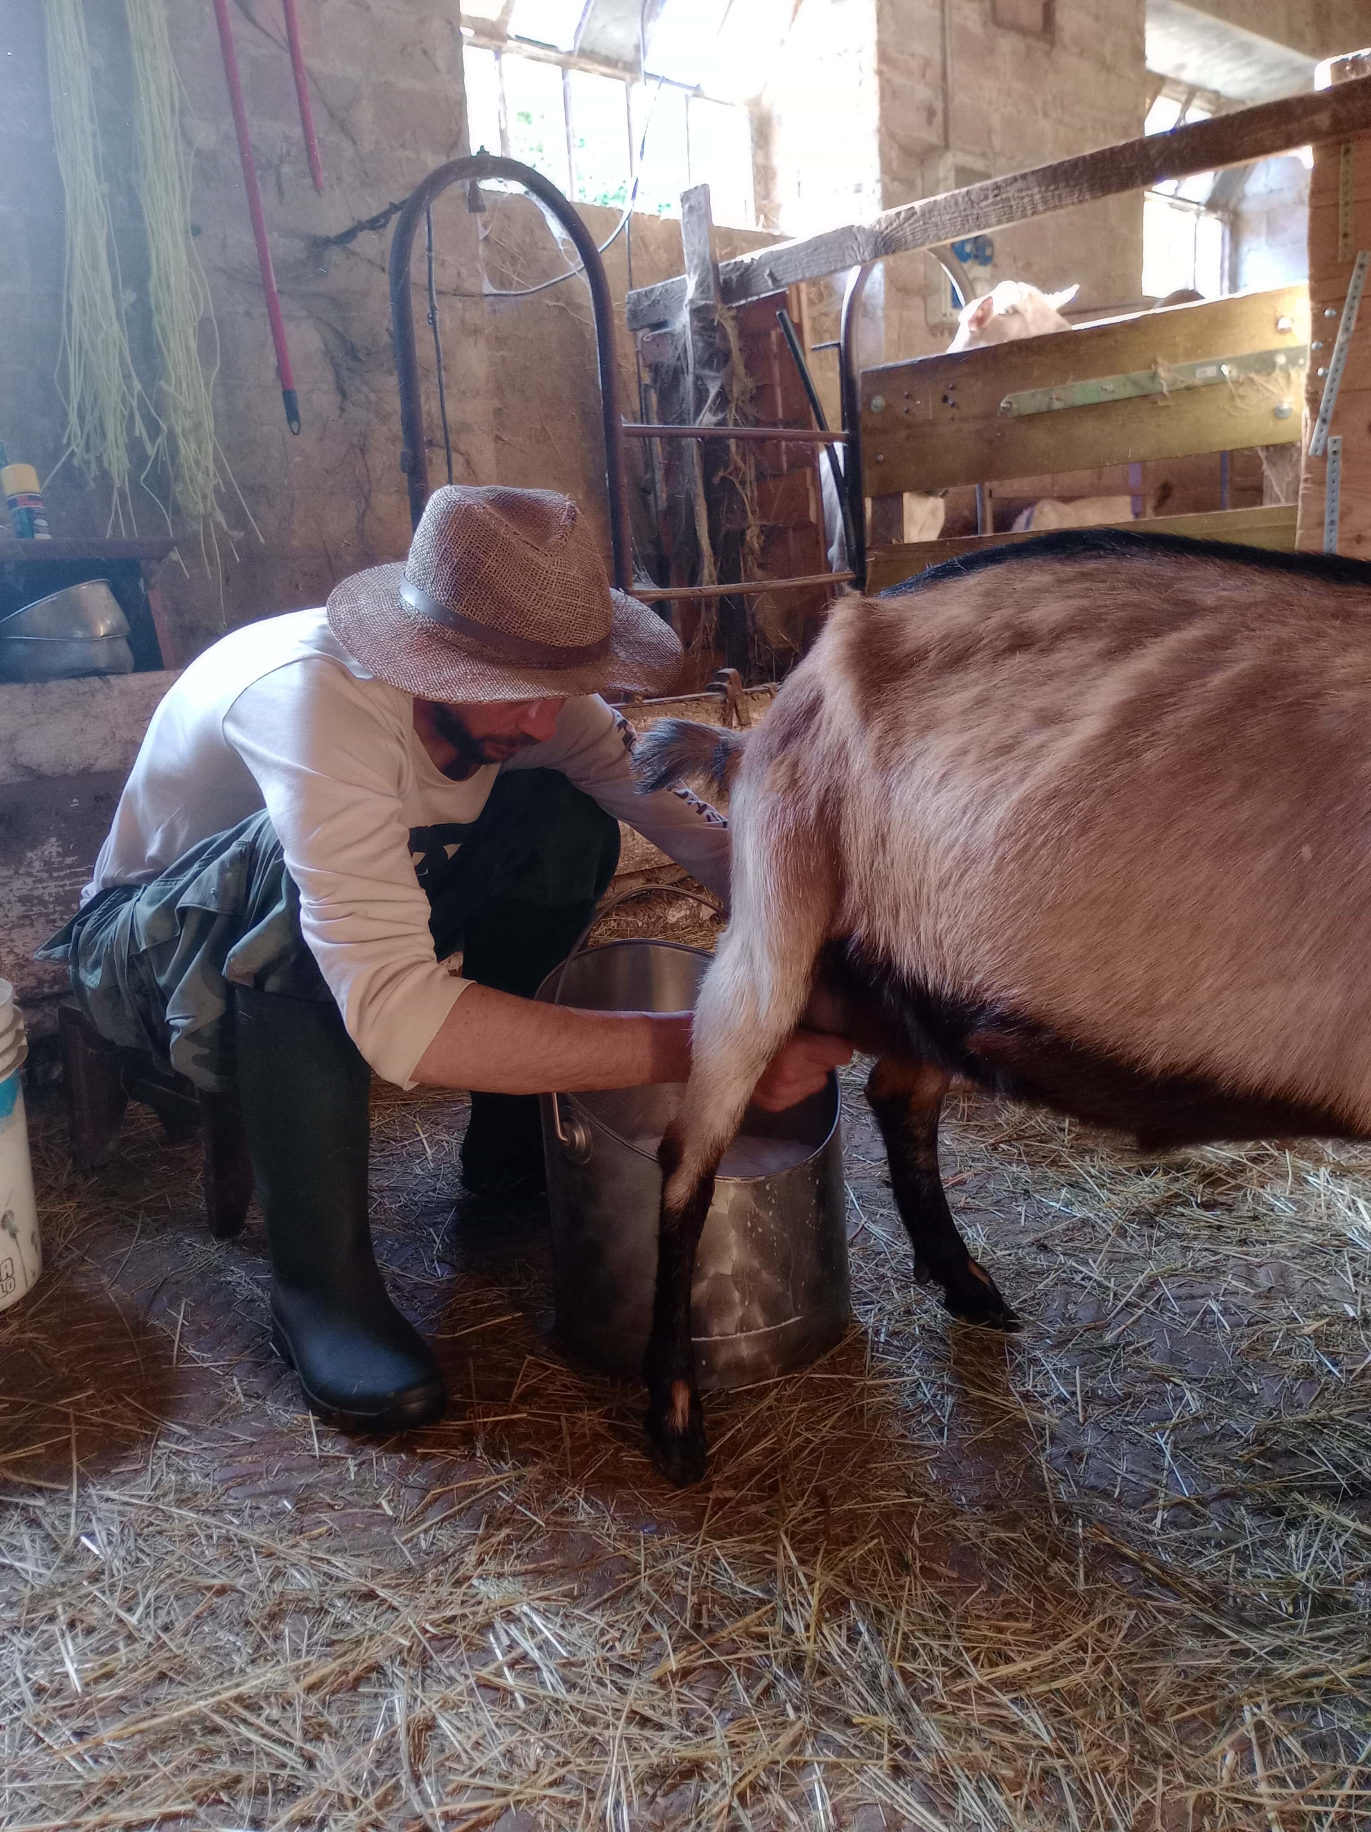
The Intangible Cultural Heritage Element
BeCountry valorises several ICH-related practices, such as:
Traditional truffle hunting
Falconry
Pastoral life (“A day as a shepherd”)
Traditional agricultural knowledge
Food production techniques
These practices are not staged performances - they are real, living traditions integrated into tourism experiences.
https://becountry.it/en

Slide 21
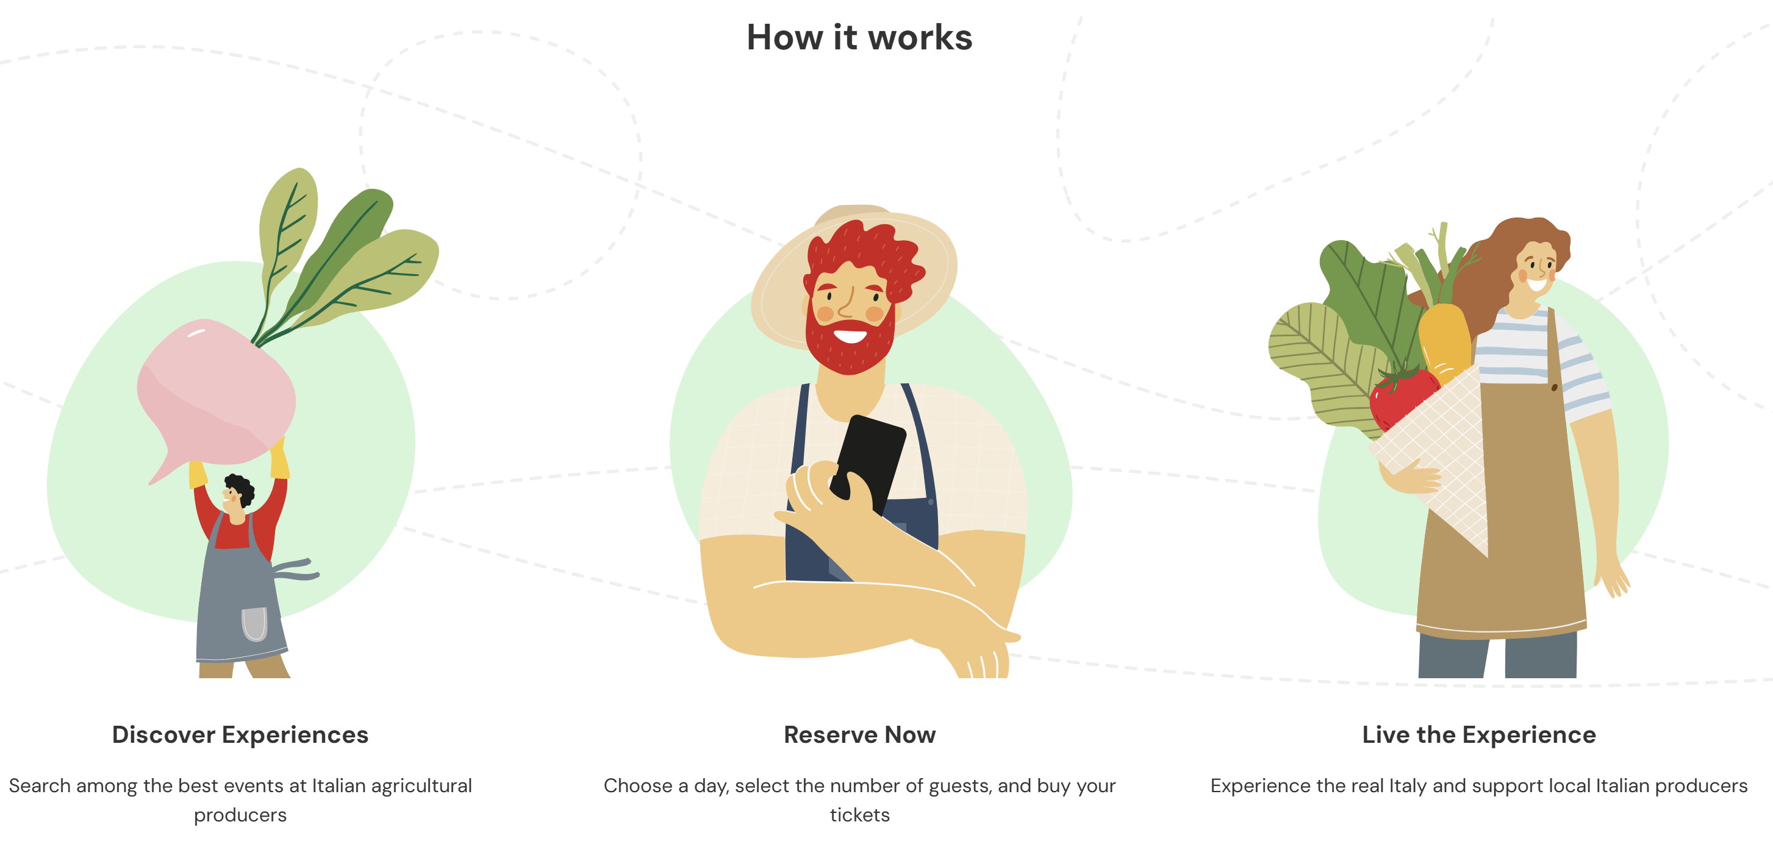
Transformation into a Tourism Experience
BeCountry structures experiences by clearly providing:
A detailed description of the activity
Location of the experience
Duration
Price per person
Availability calendar
Online booking system
Practical information
Organiser profile
The platform standardises presentation and booking, while leaving the experience design to the local host.

Slide 22
Tourism Product Components
Component | Application in BeCountry
Core attraction | Living rural traditions
Experience | Hands-on participation
Activities | Farming activities, guided experiential workshops, local farm product tastings
Supporting services | Booking system, insurance, coordination
Image | Authentic rural lifestyle
Communication and Distribution | Online promotion, digital platform, online booking system
BeCountry integrates heritage + entrepreneurship + digitalisation.

Slide 23
Why is BeCountry a Best Practice?
It professionalises intangible cultural heritage
It supports small rural enterprises
It integrates digital tools into rural tourism
It creates replicable models across regions
It bridges tradition and innovation
BeCountry demonstrates how ICH can become economically sustainable through structured digital distribution.

Slide 24
Different approaches to tourism experiences based on cultural heritage
Element | Rapone | Transhumance | BeCountry
Type of experience | Immersive village experience based on storytelling, local identity, and community interaction | Immersive experience in a living pastoral tradition, where visitors may walk with the herds, share daily activities, and temporarily experience the shepherds’ way of life | Hands-on rural experiences where visitors actively participate in traditional practices (e.g. truffle hunting, shepherding, farming)
Target visitors | Families and visitors interested in local traditions and village life | Hikers, slow tourism travellers, and visitors interested in rural and pastoral life | Visitors seeking rural, hands-on, and experiential activities
Who organises it | Local community and cultural associations | Shepherds, pastoral associations, communities, cultural organisations, tour operators | Individual farms and rural businesses
How the experience is communicated | Cultural events, local initiatives, institutional communication | Seasonal events, regional heritage promotion, cultural associations | Digital platform and online promotion
How the experience is accessed or commercialised | Participation in local events | In some contexts through organised tours, guided activities, and experiential packages | Bookable experiential activities offered by rural providers on the digital platform
These examples show that intangible cultural heritage can become a tourism experience in different ways.
There is not one single model. What matters is how heritage, experience, target visitors, and organisation are connected.

Slide 25

Reflection: best practices and your tourism product
Work individually or in your group.
Reflect and identify:
What ideas from the best practices analysed today and in the previous days have already inspired or could inspire your tourism product?
How could you apply or adapt these ideas in your own context?
Write your ideas.
Be ready to share one idea.

