Slide 1

#ASenseofEU - Training Mobility in Italy
Co-funded by the European Union.
Grant Agreement No. 2024-1-IS01-KA220-ADU-000251000
The European Commission support for the production of this publication does not constitute an endorsement of the contents which reflects the views only of the authors, and the Commission cannot be held responsible for any use which may be made of the information contained therein.
Refinement and preparation of participants’ tourism products for presentation
Gubbio (Umbria - iTALY) | 23–27 March 2026

Slide 2

Refining your tourism product
During this session, you will:
review your tourism product
clarify its key components
improve coherence and feasibility
prepare it for presentation
This is a consolidation phase.

Slide 3
What does refining mean?
Refining your tourism product means:
making your idea clearer
ensuring internal coherence
checking feasibility
strengthening the role of the ICH element
aligning experience, services and target
You are reviewing and improving what you have developed.

Slide 4
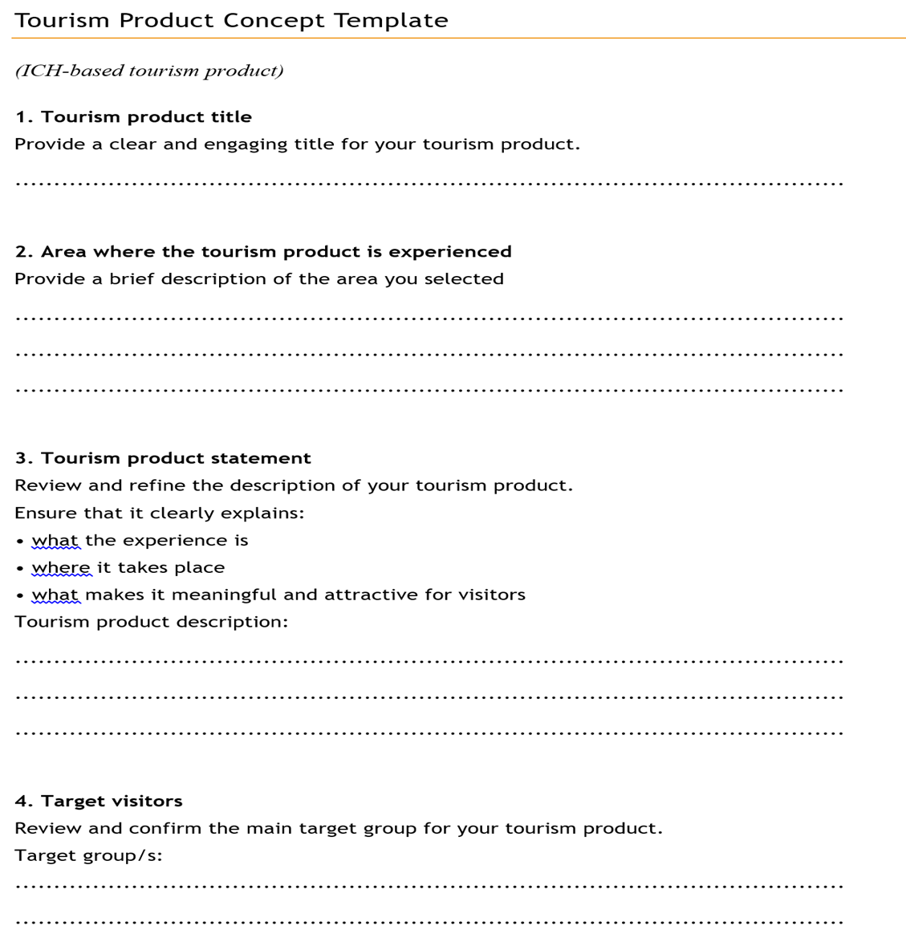
The Tourism Product Concept Template
You will use the structured template to:
check completeness
identify missing elements
prepare your final presentation
The template will guide you step by step.

Slide 5
The Tourism Product Concept Template
1. Tourism product title
Provide a clear and engaging title for your tourism product.
2. Area where the tourism product is experienced
Provide a brief description of the area you selected

Slide 6
The Tourism Product Concept Template
3. Tourism product statement
Provide the description of your tourism product.
Ensure that it clearly explains:
• what the experience is
• where it takes place
• what makes it meaningful and attractive for visitors

Slide 7
The Tourism Product Concept Template
4. Target visitors
Identify the main target group for your tourism product.
Specify the key characteristics of the identified target demand profile
Why is this tourism product suitable for this target group?

Slide 8
The Tourism Product Concept Template
5. Intangible Cultural Heritage element (core of the tourism product)
Describe the ICH element at the core of your tourism product.
Cultural practice, tradition, or knowledge involved
How will visitors experience this intangible cultural heritage element?

Slide 9
The Tourism Product Concept Template
6. Experience and activities (based on the cultural heritage element)
Describe the visitor experience and activities.
List the main activities included in the experience
7. List the main local stakeholder and partner involved in the experience

Slide 10
The Tourism Product Concept Template
8. Services and organisation (feasibility check)
Identify the services required to deliver this tourism experience.
List the key services needed
For each service, indicate whether it is already available in your area or needs to be developed

Slide 11
The Tourism Product Concept Template
9. Communication and distribution
Define how the tourism experience will be communicated and distributed to potential visitors:
Indicate which physical and/or digital channels to use to promote the designed product
Indicate which channels to use to sell the designed product

Slide 12
The Tourism Product Concept Template
10. Final reflection (preparation for presentation)
Review your tourism product and ensure that you can clearly explain:
• the tourism experience
• the intangible cultural heritage element
• the target visitors
• how the experience will take place
• the services required
• how the experience will be communicated and sell

Slide 13

Peer feedback: present and review your tourism product
Work in pairs or small groups.

Slide 14
Peer feedback: present and review your tourism product
Presenter:
Briefly present your tourism product (5 minutes).
Explain:
• your tourism product
• the intangible cultural heritage element
• the target visitors
• the experience and activities
• the services needed
• the communication and distribution channels

Slide 15
Peer feedback: present and review your tourism product
Listener:
Listen carefully and provide feedback.
Consider:
Is the tourism product clear?
Is the intangible cultural heritage element well integrated?
Is the experience coherent and meaningful?
Are the services realistic and feasible?
Are the communication and distribution channels realistic and feasible?

Slide 16

Prepare to present your tourism product
Check that your tourism product is clear and complete:
• Tourism product description
• Cultural heritage element
• Target visitors
• Experience and activities
• Services and organisation
• Communication and distribution channels
You will present your tourism product in the next session.

Slide 17
Final check
Can you explain your tourism product clearly in 2–3 minutes?
If not, clarify the missing elements now

