Slide 1
A sense of place
Gunnar Ingi Hrafnsson
The Blue Bank
Thingeyri, Iceland

Slide 2
A sense of place, what is it?
A Sense of place describes the cognitive and emotional connection between people and their environments.
It covers the unique, physical, cultural and sensory characteristics of a location.
Sensory meaning sound, smell, taste, sight and etc.

Slide 3
Understanding the sense of place
Take a moment and think about a place that means something to you!
It could be a village, a landscape, a harbour, a neighbourhood, or even a street.

Slide 4
Understanding the sense of place
Now ask yourself:
Why does this place matter to me?
What makes it different from any other place?

Slide 5
SENSE OF PLACE
It describes the cognitive and emotional relationship between PEOPLE and their ENVIRONMENT
It reflects in the geography, history, culture and community as they come together to create the identity and atmosphere of a place.

Slide 6
A sense of place is the combination of
What we see
What we hear
What we smell
The stories we tell
The traditions we practice
Creating what we could call the PERSONALITY OF A PLACE

Slide 7
People feel connected to places through memory, culture and shared experiences
Sense of place strengthens local identity, community pride and social cohesion.
It can support tourism, heritage preservation and sustainable development.

Slide 8
Why sense of place matters
Places that have a strong SENSE OF PLACE tend to be places where people feel
BELONGING
PRIDE
ATTACHMENT

Slide 9
What makes a place unique?
Landscape and Geography
History
Culture and Traditions
Community and People
Sensory Experience

Slide 10
Sense of place in rural and remote areas
In rural and remote areas, SENSE OF PLACE is often particularly strong
Strong connection to landscape
Long-standing traditions
Close-knit communities
Shared history and knowledge

Slide 11
Places carry meaning
Places are not neutral they carry layers of meaning

Slide 12
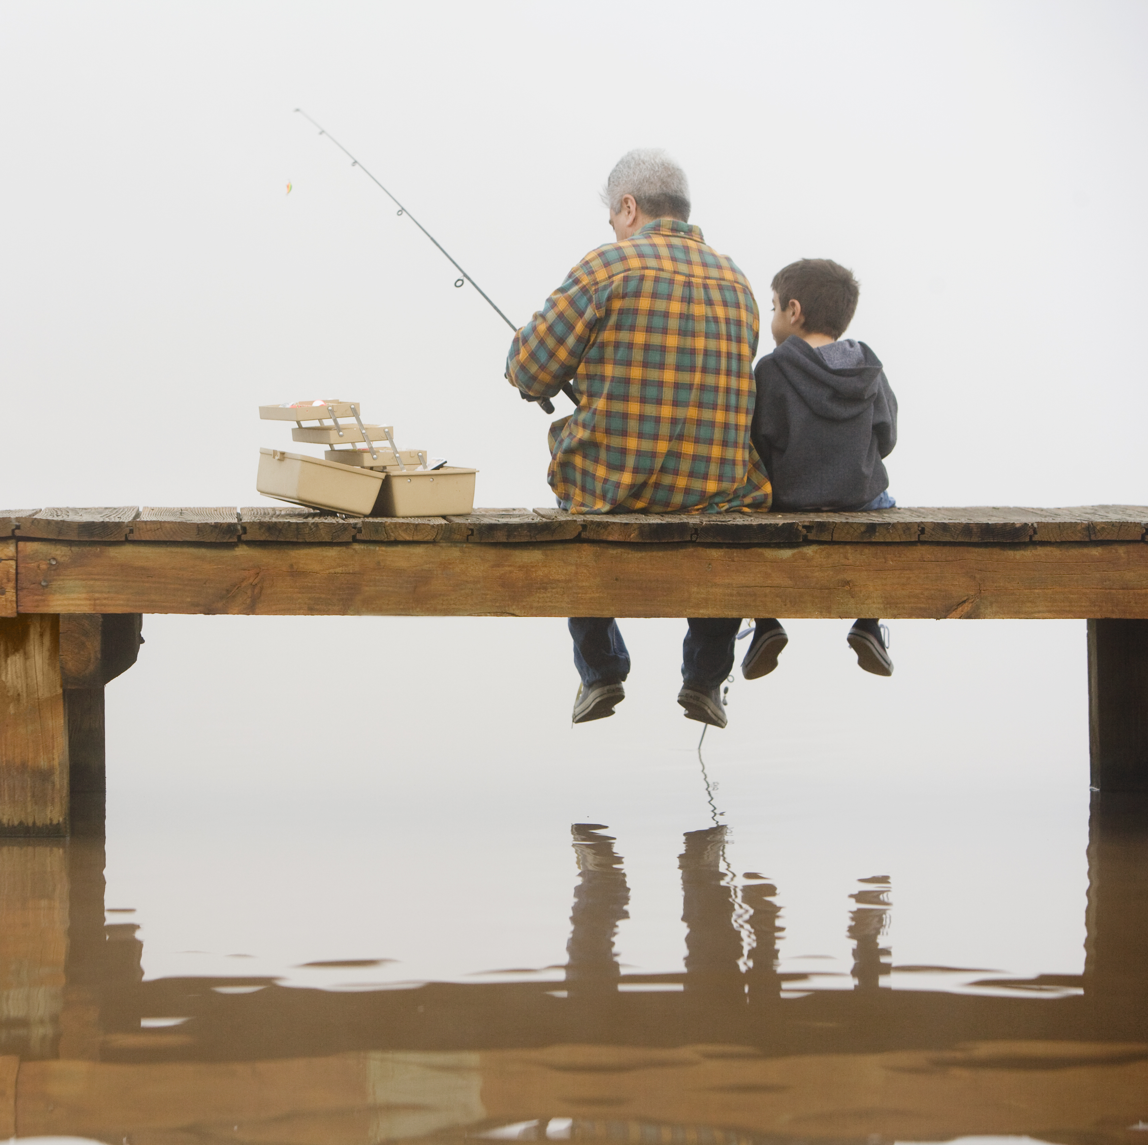
Places carry meaning
A PIER
Livelihoods
Fishing traditions
Family history

Slide 13
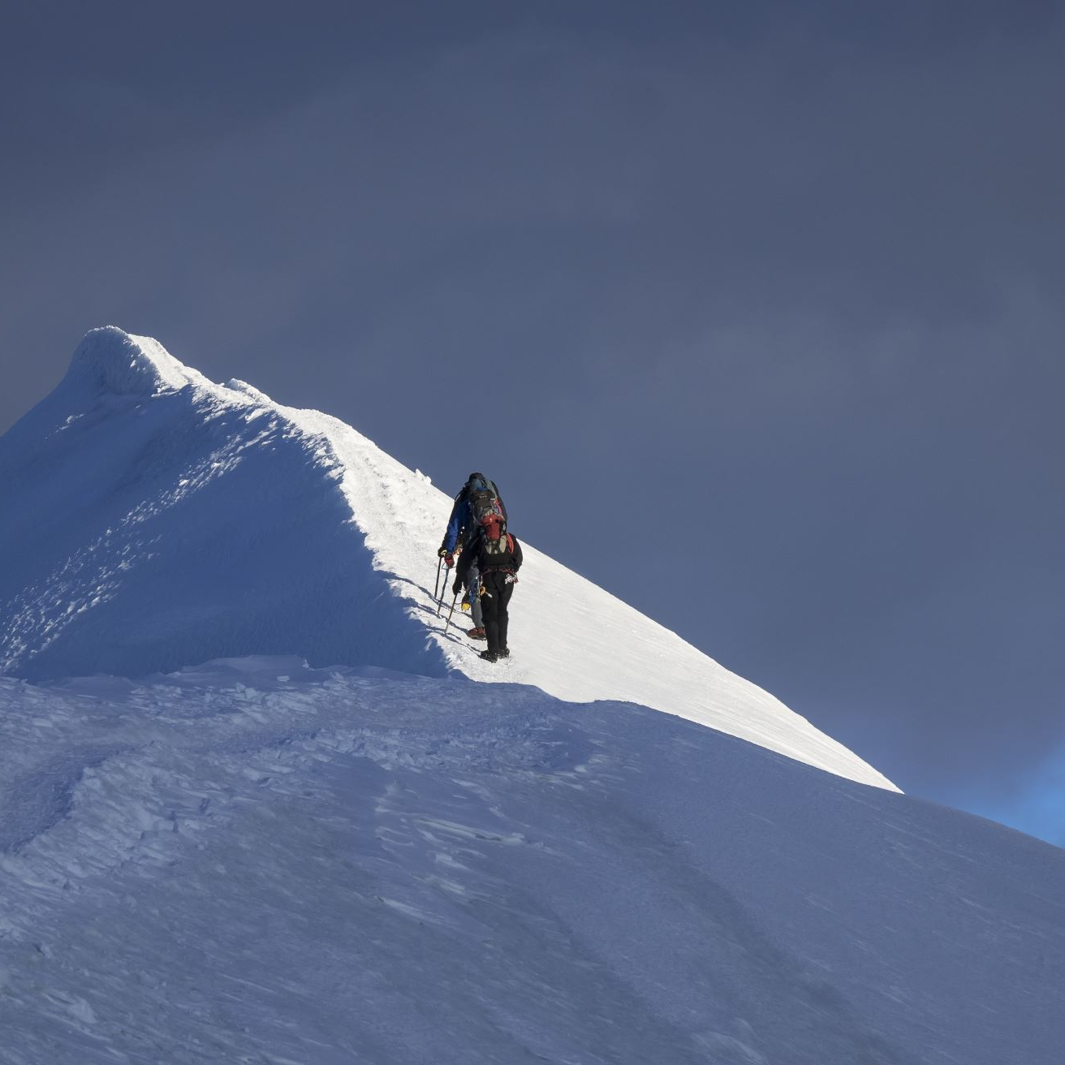
Places carry meaning
A MOUNTAIN
Survival
Identity
Spiritual connection

Slide 14
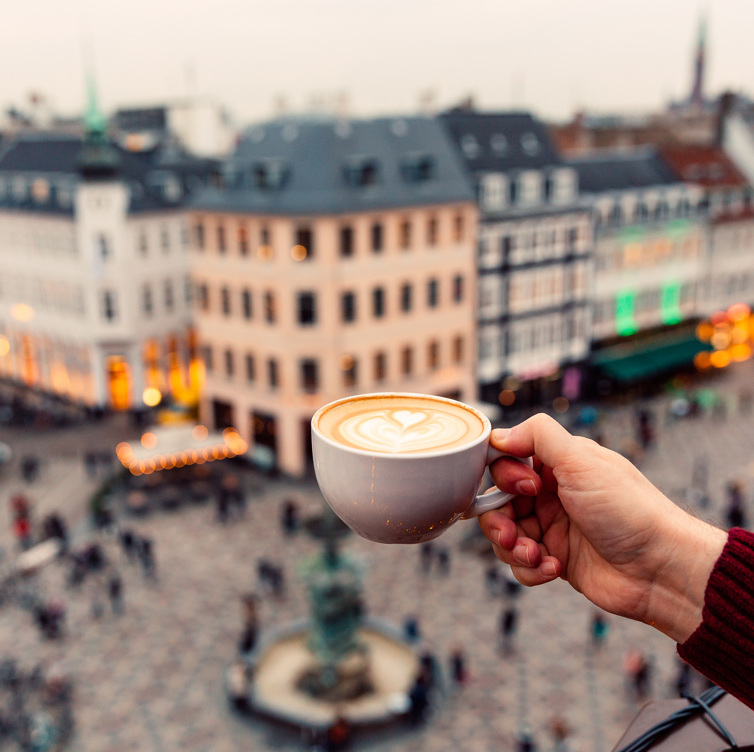
Places carry meaning
A TOWN SQUARE
Celebration
Community Gatherings
Shared memories

Slide 15
Sense of place workshop the questions we will explore today
What makes your place unique?
  What defines the character of your community?
  What qualities do we value in rural and remote places?
  What memories, traditions, or experiences are tied to your landscape?
  HOW CAN WE RECOGNISE, PROTECT AND STRENGTHEN THE SENSE OF PLACE IN OUR COMMUNITIES?

Slide 16
GROUP WORK
40 min
WITH THE LOCATION YOU HAVE CHOSEN
What physical features define the place?
What traditions or cultural practices exist there?
What stories or memories are connected to it?
What activities happen there today?
What emotions do people associate with it?

Slide 17
let's share

Slide 18
BREAK
15 minutes breather

Slide 19
Summary of what we have discussed
A SENSE OF PLACE is the connection between PEOPLE and their ENVIRONMENTS
It is physical, emotional, historical, cultural and sensory characteristics of a location
It reflects of the GEOGRAPHY, HISTORY, CULTURE and COMMUNITY come together to create the identity and atmosphere of a place.
It can support TOURISM, HERITAGE PRESERVATION and SUSTAINABLE DEVELOPMENT
In rural and remote areas, SENSE OF PLACE is often particularly strong
Places carry meaning.

Slide 20
What qualities do we appreciate in rural and remote areas?

Slide 21
Group work – The Story of a place
20 min
If the place you are working with could tell its story, what would it say?
Past – what used to happen here?
Present – what happens here today?
Future – what should be preserved?
PREPARE A SHORT PRESENTATION TO SHARE WITH US

Slide 22

Final reflection
What makes your place unique?
What elements should be protected or passed on?

